Slide 1
Module 3: Individual Peacekeeping Personnel
Lesson
3.4
Sexual Exploitation and Abuse

Slide 2
Aim
To ensure all peacekeeping personnel know the UN prohibits sexual exploitation and abuse and the standards of conduct and behaviour the UN requires in this regard.
UN Core Pre-Deployment Training Materials 2016

Slide 3
Relevance
Allegations of sexual exploitation and abuse (SEA) by UN personnel
UN zero tolerance policy on SEA
Obligation of ALL
UN Core Pre-Deployment Training Materials 2016

Slide 4
Learning Outcomes
Learners will:
Explain “zero tolerance of SEA”
Describe SEA and uniform standards on SEA
Describe DPKO three-pronged approach
Explain responsibility of peacekeeping personnel
UN Core Pre-Deployment Training Materials 2016

Slide 5
Learning Overview
Duty to “Protect and Serve”
Zero Tolerance of Sexual Abuse
Definition of SEA
Uniform Standards on SEA – Prohibited Acts
DPKO’s Three-Pronged Approach to SEA
Responsibility for Conduct on SEA
UN Core Pre-Deployment Training Materials 2016

Slide 6
Duty to “Protect and Serve”
Your behaviour as UN staff upholds the confidence and trust of the people you have come to serve
UN Core Pre-Deployment Training Materials 2016

Slide 7
Zero Tolerance of Sexual Abuse
Impunity and complacency not tolerated
Active measures to prevent SEA
Action against ALL violators
UN Core Pre-Deployment Training Materials 2016

Slide 8
Definition of SEA
Sexual exploitation: actual or attempted abuse of a person’s vulnerability, differential power or trust for sexual purposes, including profiting monetarily, socially or politically from the exploitation
Sexual abuse: actual or threatened physical intrusion of a sexual nature, by force or under unequal or coercive conditions
Sexual exploitation and abuse constitute Category I serious misconduct
UN Core Pre-Deployment Training Materials 2016

Slide 9
Interpreting Key Words
Vulnerable | Fighting for survival in desperate circumstances Lack of awareness of rights and obligations, denial of human rights Unequal power relations that can be exploited Prevalence of sexual and gender-based violence
Differential Power | An imbalance between economic, social, education and professional status A dependence by one person on another to sustain life A position of authority of one person over another
Abuse of Trust | Further victimizes vulnerable persons Violates victims’ human rights Disrupts families/communities and undermines peace
Beneficiaries of Assistance | Broadly interpreted to cover the local population the PKO is mandated to serve
UN Core Pre-Deployment Training Materials 2016

Slide 10
Difference with Sexual Harassment
Sexual harassment: any unwelcome sexual advance, request for sexual favour, verbal or physical conduct or gesture of a sexual nature or any other behaviour of a sexual nature that might reasonably be expected or be perceived to cause offence or humiliation to another, when such conduct interferes with work, is made a condition of employment or creates an intimidating, hostile or offensive work environment
UN Core Pre-Deployment Training Materials 2016

Slide 11
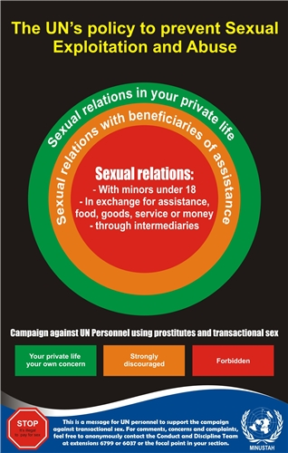
Uniform Standards on SEA – Prohibited Acts
Sexual activity with children (persons under the age of 18) is prohibited
Exchange of money, employment, goods, assistance or services for sex, e.g. sex with prostitutes is prohibited
Use of children or adults to procure
sexual services for others is prohibited
Sexual relationships with beneficiaries
of assistance are strongly discouraged
UN Core Pre-Deployment Training Materials 2016

Slide 12
DPKO’s Three-Pronged Approach to Addressing SEA
Prevention
Enforcement
Remedial action
UN Core Pre-Deployment Training Materials 2016

Slide 13
Preventive Measures
Uniform standards on SEA
Training
Public information
Welfare and recreation
UN Core Pre-Deployment Training Materials 2016

Slide 14
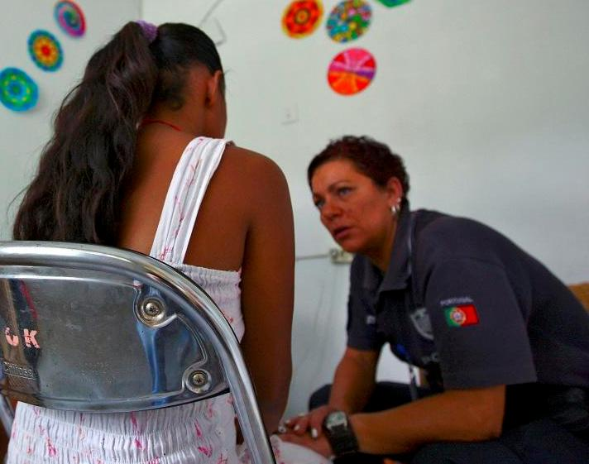
Enforcement Measures
Complaints mechanism/reporting
Data management
Investigations
Follow-up
UN Core Pre-Deployment Training Materials 2016

Slide 15
Enforcement Measures
Complaints Mechanism/Reporting:
CDT & OIOS – the main entities
Locked drop-boxes
Private meeting rooms for confidential reporting
Telephone hotlines
Secure email addresses
Focal points
Civil society/UN networks
UN Core Pre-Deployment Training Materials 2016

Slide 16
Enforcement Measures
Data Management:
Misconduct Tracking System (MTS): a global database and confidential tracking system for monitoring allegations and cases
All allegations received are referred for investigation
UN Core Pre-Deployment Training Materials 2016

Slide 17
Enforcement Measures
Investigations:
CDT performs assessment of allegations
Investigation entities: national authorities, OIOS and mission entities, ad-hoc panels
Six-month timeline for completing investigations
Immediate Response
Teams to gather/preserve
evidence
UN Core Pre-Deployment Training Materials 2016

Slide 18
Enforcement Measures
Follow-Up: If the allegation is substantiated
For staff members: | UN takes disciplinary action Substantiated cases of criminal conduct can also be referred for prosecution or directly prosecuted by national authorities
For those personnel deployed with the status of experts on mission, essentially police personnel and military observers | Disciplinary action determined by the deploying Member State UN can take only limited action Substantiated cases of criminal conduct can also be referred for prosecution or directly prosecuted by national authorities
For military personnel: | Disciplinary action or criminal sanctions are determined by TCC UN can take only limited action TCCs are required to report back to the UN on outcome of misconduct investigations and prosecutorial actions taken
UN Core Pre-Deployment Training Materials 2016

Slide 19
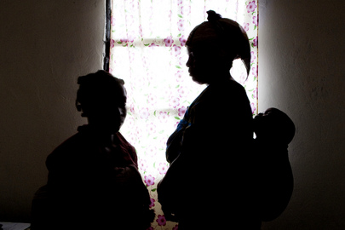
Remedial Action
Victim assistance
Reputation repair
Regular briefings
UN Core Pre-Deployment Training Materials 2016

Slide 20
Who is Responsible?
Individual Responsibility
Professional and personal
Reflect UN
Uniform standards on SEA
Personal discipline
Duty to SEA-free environment
Duty to report SEA
UN Core Pre-Deployment Training Materials 2016

Slide 21
Leadership and Accountability
Implement policies
Mandatory SEA training by ALL
Focal Points and awareness-raising
Welfare and recreation
Emphasize duty to report
Address violations
Report all misconduct to CDT or OIOS
UN Core Pre-Deployment Training Materials 2016

Slide 22
Summary of Key Messages
“Zero tolerance of SEA”
SEA and uniform standards on SEA
DPKO three-pronged approach
Responsibility of peacekeeping personnel
UN Core Pre-Deployment Training Materials 2016

Slide 23
Questions
UN Core Pre-Deployment Training Materials 2016

Slide 24
Learning Activity
Learning Evaluation
UN Core Pre-Deployment Training Materials 2016

Slide 25
Learning Activity 3.4.2
Definition of SEA
Sexual exploitation: actual or attempted abuse of a person’s vulnerability, differential power or trust for sexual purposes, including profiting monetarily, socially or politically from the exploitation
Sexual abuse: actual or threatened physical intrusion of a sexual nature, by force or under unequal or coercive conditions
Sexual exploitation and abuse constitute Category I serious misconduct
UN Core Pre-Deployment Training Materials 2016

