Slide 1

Module 2: Mandated Tasks of United Nations Peacekeeping Operations
Lesson
2.5
Conflict Related Sexual Violence

Slide 2

Aim
To provide an understanding of the obligations of peacekeeping personnel in effectively addressing conflict related sexual violence (CRSV).
UN Core Pre-Deployment Training Materials 2016

Slide 3
Relevance
Peacekeeping personnel are expected to:
Protect civilians – including from sexual violence in conflict
Protect women and children – especially vulnerable
UN Core Pre-Deployment Training Materials 2016

Slide 4
Learning Outcomes
Learners will:
Explain CRSV
Identify CRSV as a punishable crime
Describe roles and responsibilities of peacekeeping personnel
Explain how a peacekeeping operation (PKO) coordinates action to address CRSV
UN Core Pre-Deployment Training Materials 2016

Slide 5
Learning Overview
Special Attention to Sexual Violence in Conflict
Definition
UN Leads in Addressing CRSV
Legal Framework
UN Guidance on CRSV
Addressing CRSV in UN Peacekeeping
Roles and Responsibilities
Coordination with Partners
What Individual Peacekeeping Personnel Can Do
UN Core Pre-Deployment Training Materials 2016

Slide 6
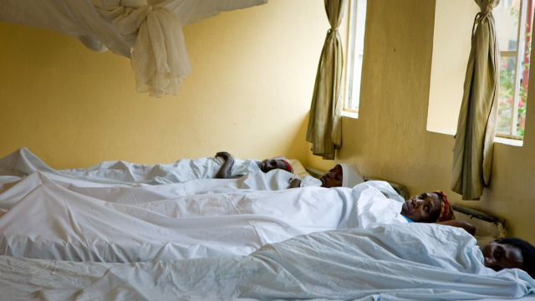
Special Attention to
Sexual Violence in Conflict
Prevalent in conflicts – tactic of war
Increased risk for women and girls
Traumatic effects
Culture of impunity
UN Core Pre-Deployment Training Materials 2016

Slide 7
Definition
“CRSV refers to incidents or patterns of sexual violence in conflict or post-conflict situations which include: rape, sexual slavery, forced prostitution, forced pregnancy, enforced sterilization or any other form of sexual violence of comparable gravity against women, men, girls or boys”.
UN Core Pre-Deployment Training Materials 2016

Slide 8
Realities on the Ground
Vulnerable civilians, situations | Threats
Perpetrators, capacity to act | Local community protection strategies
UN Core Pre-Deployment Training Materials 2016

Slide 9
Differences with Related Issues
Gender based violence (GBV)
Sexual and gender based violence (SGBV)
Sexual exploitation and abuse (SEA)
Harmful traditional practices
“Survival sex”
UN Core Pre-Deployment Training Materials 2016

Slide 10
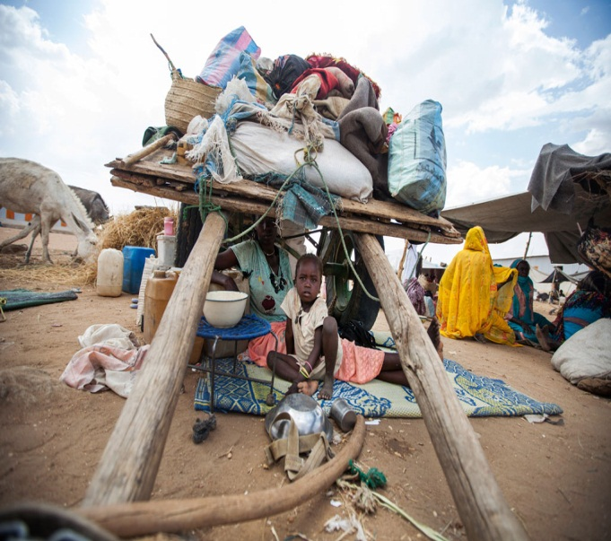
Links with Cross-Cutting Thematic Tasks
Human rights
Protection of civilians (POC)
Women peace and security (WPS)
Child protection
UN Core Pre-Deployment Training Materials 2016

Slide 11
UN Headquarters Roles and Responsibilities in
Addressing CRSV
Special Representative of the Secretary-General on Sexual Violence in Conflict (SRSG-SVC)
Team of Experts
UN Action Against Sexual Violence in Conflict
UN Entity for Gender Equality and the Empowerment of Women (UN Women)
DPKO
UN Core Pre-Deployment Training Materials 2016

Slide 12

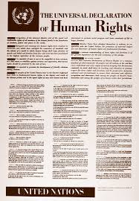



Legal Framework
International law
National law
Security Council resolutions
UN Core Pre-Deployment Training Materials 2016

Slide 13
UN Guidance on CRSV
Secretary-General’s Policy Committee Decision No. 2010/30
DPKO/DFS Policy on Mainstreaming and Implementing the CRSV Mandate in UN PKOs
DPKO/DFS Guidelines on CRSV
The Analytical Inventory of Peacekeeping Practice (2010)
Early-Warning Indicators Matrix
UN Core Pre-Deployment Training Materials 2016

Slide 14
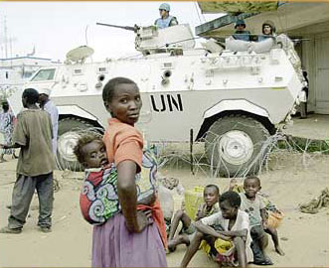
Addressing CRSV in UN Peacekeeping
Prevention and response measures
Political dialogue and advocacy
Community engagement
UN presence for vulnerable areas/populations
Situational awareness, early-warning, operational readiness,
commitment
UN Core Pre-Deployment Training Materials 2016

Slide 15
Roles and Responsibilities
Women Protection Adviser
Advise mission leadership
Mainstream CRSV issues
Establish monitoring, analysis and reporting arrangements (MARA)
Carry out prevention activities
Dialogue with parties to the conflict
Strengthen coordination
Training and capacity-building
Goal
Prevent & Respond to CRSV
UN Core Pre-Deployment Training Materials 2016

Slide 16
Other Units
Gender Adviser
Protection of Civilians
Child Protection
Human Rights
JOC/JMAC
SRSG’s Office
Rule of Law/Judicial Affairs
SSR
DDR
Political Affairs
Corrections
Civil Affairs
Public Information
UN Core Pre-Deployment Training Materials 2016

Slide 17
Special Roles of Military and Police
Physical protection
Proactive approach
Monitoring and reporting
Investigations
Prevent & Respond to CRSV
UN Core Pre-Deployment Training Materials 2016

Slide 18

Coordination with Partners
UNCT coordinates services for survivors:
  Health care
  Psychosocial support
  Legal aid
  Socio-economic reintegration services or livelihood support
UN Core Pre-Deployment Training Materials 2016

Slide 19
What Individual Peacekeeping Personnel Can Do
Support and encourage local authorities in addressing and combatting CRSV
Consult women and men
Talk to women and men separately
Be proactive to prevent CRSV
Respond to potential/actual threats
Share information
Locate local organizations for victim assistance
UN Core Pre-Deployment Training Materials 2016

Slide 20
Summary of Key Messages
Conflict related sexual violence (CRSV)
CRSV as a punishable crime
Roles and responsibilities of peacekeeping personnel
How a peacekeeping operation (PKO) coordinates action to address CRSV
UN Core Pre-Deployment Training Materials 2016

Slide 21
Questions
UN Core Pre-Deployment Training Materials 2016

Slide 22
Learning Activity
Learning Evaluation
UN Core Pre-Deployment Training Materials 2016

