Slide 1

Module 2: Mandated Tasks of United Nations Peacekeeping Operations
Lesson
2.1
Mandated Tasks

Slide 2

Aim
To introduce Security Council mandated tasks for UN Peacekeeping Operations (UNPKOs) and detail roles for mission components and partners.
UN Core Pre-Deployment Training Materials 2016

Slide 3
Relevance
Missing text for this slide:
Insert text
UN Core Pre-Deployment Training Materials 2016

Slide 4
Learning Outcomes
Learners will:
Identify the four categories of mandated tasks
List examples of mandated tasks which are the core business of UNPKOs
Describe two critical areas where UNPKOs play a limited “support” role
UN Core Pre-Deployment Training Materials 2016

Slide 5
Learning Overview
Overview of Mandated Tasks
Supervision or Monitoring of the Ceasefire Agreement
Provision of a Secure and Stable Environment
Facilitating the Political Process
Facilitating the Delivery of Humanitarian Assistance
Supporting Poverty Reduction and Economic Development
UN Core Pre-Deployment Training Materials 2016

Slide 6
Overview of Mandated Tasks
The range of mandated tasks may be categorized in the following way:
Core business
Peacebuilding activities
Support roles
Cross-cutting thematic tasks
UN Core Pre-Deployment Training Materials 2016

Slide 7
The Core Business
Supervision or monitoring of the ceasefire agreement
Provision of a secure and stable environment
Facilitating the political process
UN Core Pre-Deployment Training Materials 2016

Slide 8
Peacebuilding Activities
Mine action
Disarmament, demobilization and reintegration (DDR) of combatants
Security sector reform (SSR)
Rule of law (ROL)-related activities
Protection and promotion of human rights
Electoral assistance
Support to the restoration and extension of state authority
UN Core Pre-Deployment Training Materials 2016

Slide 9
Support Roles
Facilitating the delivery of humanitarian assistance
Cooperating and coordinating with mission partners to support poverty reduction and economic development
UN Core Pre-Deployment Training Materials 2016

Slide 10
Cross-Cutting Thematic Tasks
Human Rights
Protection of civilians
Conflict-related sexual violence
Child protection
Women, peace and security
UN Core Pre-Deployment Training Materials 2016

Slide 11
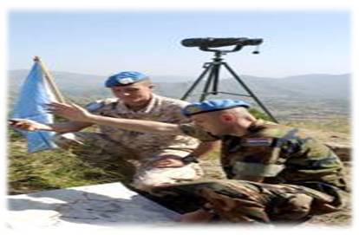
Supervision or Monitoring of the
Ceasefire Agreement
Ceasefire agreement: refers to a temporary stoppage of war or any armed conflict for an agreed-upon timeframe or within a limited area
Monitoring peace agreements:
involves actions to gather
information on compliance with
an agreement
By monitoring, PKOs reassure
parties will not exploit ceasefire to gain military advantage
UN Core Pre-Deployment Training Materials 2016

Slide 12
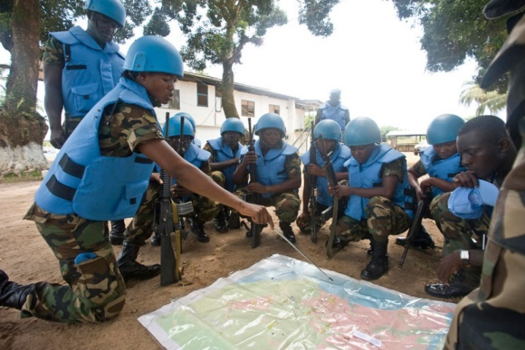
Provision of a Secure and Stable Environment
A secure environment is generally a pre-condition for moving ahead on several elements of peace agreements
By helping to fill security/public order vacuum, PKOs play a critical role in securing the peace process and creating a safe environment for humanitarian and development actors
Primary role of the military
component
UN Core Pre-Deployment Training Materials 2016

Slide 13
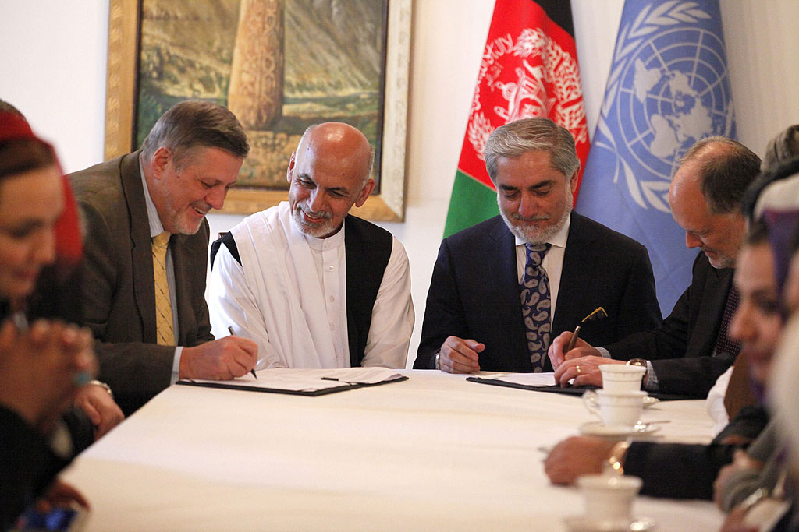
Facilitating the Political Process
PKO facilitates the political process by promoting dialogue and reconciliation and supporting the establishment of legitimate and effective institutions of governance
Important for achieving a lasting settlement or longer-term political solutions to violent conflict
UN Core Pre-Deployment Training Materials 2016

Slide 14
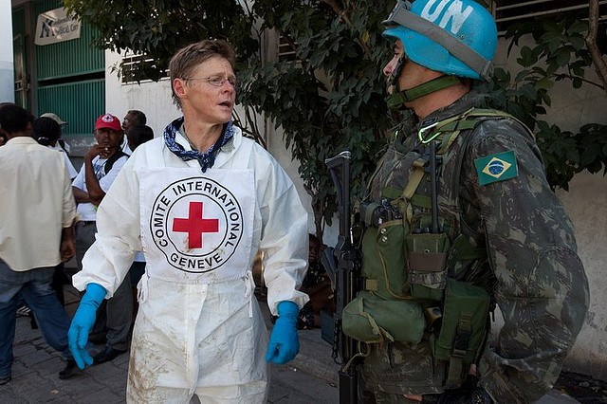
Facilitating the Delivery of
Humanitarian Assistance
Humanitarian assistance: aid and action designed to save lives, alleviate suffering and maintain and protect human dignity during and in the aftermath of man-made crises and natural disasters
Includes basic supplies of drinking water, food, shelter, medical care, protection and assistance to refugees and
IDPs
UN Core Pre-Deployment Training Materials 2016

Slide 15
Responsibilities
Host Country
International and National Humanitarian Actors
e.g. UN agencies, ICRC, NGOs
Has Capacity
If No
If Yes
UN PKO assists by providing a secure environment
Initiates, coordinates and delivers humanitarian assistance
UN Core Pre-Deployment Training Materials 2016

Slide 16
“Humanitarian Space”
An environment where receipt of humanitarian assistance is independent of military and political action
Ensures safety and feasibility of humanitarian actions and personnel
Four humanitarian principles: humanity, neutrality, impartiality and independence
Complementary concepts for civil-military coordination: UN-CIMIC (UNPKO) and UN-CMCoord (OCHA)
UN Core Pre-Deployment Training Materials 2016

Slide 17


Supporting Poverty Reduction and
Economic Development
Poverty reduction: ‘pro-poor’ policies and policies to stimulate economic growth, raise incomes and indirectly reduce poverty
Poverty eradication is an indispensable requirement for sustainable development
PKO cooperates and coordinates with national partners, UNCT and external partners
UN Core Pre-Deployment Training Materials 2016

Slide 18
Summary of Key Messages
INSERT TEXT
UN Core Pre-Deployment Training Materials 2016

Slide 19
Questions
UN Core Pre-Deployment Training Materials 2016

Slide 20
Learning Activity
Learning Evaluation
UN Core Pre-Deployment Training Materials 2016

