Slide 1

Module 1: An Overview of United Nations Peacekeeping Operations
Lesson
1. 7
Working as One in the Mission

Slide 2

Aim
To a) introduce the roles and tasks of the substantive components in UN peacekeeping operations and b) stress the importance of working together on the mission mandate.
UN Core Pre-Deployment Training Materials 2016

Slide 3
Relevance
As peacekeeping personnel you must know:
Your work
Work of other components in the mission
How all work connects
Important contribution to mandate implementation
UN Core Pre-Deployment Training Materials 2016

Slide 4
Learning Outcomes
Learners will:
Explain importance of working together to achieve the mandate
Explain differences in “institutional culture” between military, police and civilians
Explain main role of military, police and civilians
UN Core Pre-Deployment Training Materials 2016

Slide 5
Lesson Overview
The Importance of Different Mission Components Working Together
Cooperating Across Differences in Institutional Culture
The Military Component
The Police Component
The Civilian Component
Working Together in Multi-Dimensional Peacekeeping
UN Core Pre-Deployment Training Materials 2016

Slide 6
The Importance of Different Mission Components Working Together
Work of each component affects tasks of others
All contribute to achieving mandate
Complex mandates, difficult environments – must help each other
Military
Civilian
Police
UN Core Pre-Deployment Training Materials 2016

Slide 7
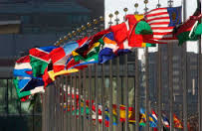
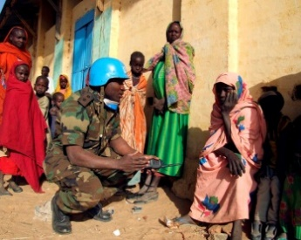
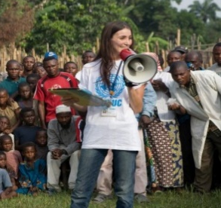
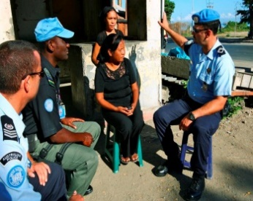

Cooperating Across Differences in Institutional Culture
Military: system of hierarchy, clear lines of authority
Civilians: flexible management models
Police: familiar lines of authority to military
Civilians versus Military/Police: ambiguity versus strong planning culture
UN Core Pre-Deployment Training Materials 2016

Slide 8
Cooperating Across Differences in Institutional Culture
Respect for diversity
Be open to cooperation
Learn about others’ work
Share work
UN Core Pre-Deployment Training Materials 2016

Slide 9
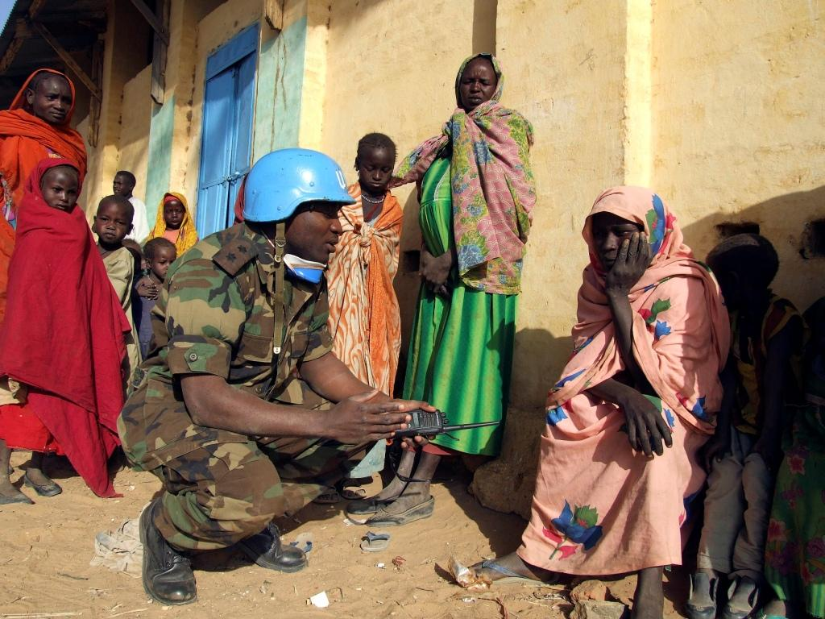
The Military Component
The Role
Primary function:
Provide a secure environment as a precondition for moving ahead on other elements of the peace process
Military
UN Core Pre-Deployment Training Materials 2016

Slide 10
Three Main Categories
Formed Military Units or Contingents
Military Experts on Mission
Staff Officers
UN Core Pre-Deployment Training Materials 2016

Slide 11

The Police Component
The Role
Two core functions:
Operational support/interim
executive policing and other
law enforcement
Support for reform, restructuring
and rebuilding of host State police
Police
UN Core Pre-Deployment Training Materials 2016

Slide 12
Three Main Categories
Individual Police Officers
Formed Police Units
Specialized Police Teams
UN Core Pre-Deployment Training Materials 2016

Slide 13
Diversity of Policing Cultures
Different legal systems, structures, approaches to policing
Leads to misunderstanding of local legal systems in host country
UNPOL need to develop basic understanding of local laws
UN Core Pre-Deployment Training Materials 2016

Slide 14

The Civilian Component
The Role
Provides technical expertise for both substantive and support work
Wide variety within civilian component
Civilian
UN Core Pre-Deployment Training Materials 2016

Slide 15
Two Different Types
Civilian Substantive Component
Civilian Support Component
UN Core Pre-Deployment Training Materials 2016

Slide 16
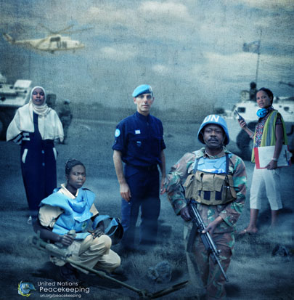
Working Together in Multi-Dimensional Peacekeeping
UN Core Pre-Deployment Training Materials 2016

Slide 17
Summary of Key Messages
Importance of working together to achieve the mandate
Differences in “institutional culture” between military, police and civilians
Main role of military, police and civilians
UN Core Pre-Deployment Training Materials 2016

Slide 18
Questions
UN Core Pre-Deployment Training Materials 2016

Slide 19
Learning Activity
Learning Evaluation
UN Core Pre-Deployment Training Materials 2016

