Slide 1

Module 1: An Overview of United Nations Peacekeeping Operations
Lesson
1. 5
Security Council Mandates in Practice

Slide 2

Aim
To explain how Security Council mandates are set up and used to direct a peacekeeping mission
UN Core Pre-Deployment Training Materials 2016

Slide 3
Relevance
All peacekeeping personnel need to:
Know
Follow
Implement
the Security Council mandate
UN Core Pre-Deployment Training Materials 2016

Slide 4
Learning Outcomes
Learners will:
Explain why peacekeeping personnel must know the mandate
Describe how Security Council (SC) monitors mandate implementation
List 3 key documents that “operationalize” SC mandates
Explain why all armed UN peacekeeping personnel must know rules of engagement (ROE) or directive on use of force (DUF)
UN Core Pre-Deployment Training Materials 2016

Slide 5
Lesson Overview
SC Mandates
Why should Peacekeeping Personnel be Familiar with the SC Mandate?
Establishing the Mandate for a Peacekeeping Operation
Translating the SC Mandate into an Operational Framework
Monitoring the Mandate
Completion of the Mandate
UN Core Pre-Deployment Training Materials 2016

Slide 6
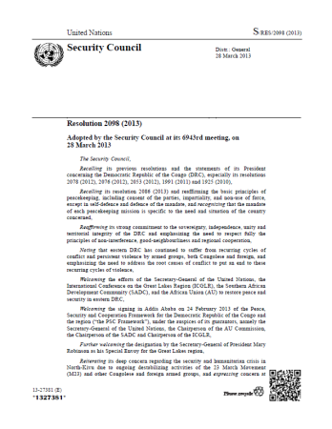
Security Council Mandates
Set tasks required, including cross-cutting, thematic tasks based on international law
UN Core Pre-Deployment Training Materials 2016

Slide 7
Why should Peacekeeping Personnel be Familiar with the Security Council Mandate?
Expected to implement mandate
Need to explain peacekeeping mission’s (PKO) presence
UN Core Pre-Deployment Training Materials 2016

Slide 8
Establishing the Mandate for a
Peacekeeping Mission
1. Initial Consultation with relevant UN actors, host government, parties on the ground and other partners
2. Secretary-General may request a strategic assessment to identify possible options for UN engagement
3. Technical field assessment mission will analyze and assess the overall security,
political, military, humanitarian and human rights situation on the ground
4. Security Council adopts a resolution with the mission mandate
UN Core Pre-Deployment Training Materials 2016

Slide 9
Translating the Security Council Mandate
into an Operational Framework
Mission Planning Process Diagram
Preparatory Planning
Planning
Decision / Implementation
SG proposes
PKO or SPM
Technical assessment
SG report to SC
SC mandate
Appoint SRSG/ Head of Mission
Mission Concept
Draft Mission Concept
Draft component/ operational plans
Directive to SRSG
Component-specific plans
Budget submission
Recommendation to the SG to establish
a mission
Strategic assessment with UNCT/
other partners
Integrated Strategic Framework with UNCT
UN Core Pre-Deployment Training Materials 2016

Slide 10
Translating the Security Council Mandate
into an Operational Framework
Multi-Year Plans
Annual Plans
UN-wide and multi-agency plans
UN Integrated Strategic Framework (ISF)
Other UN and non-UN plans
Mission-wide plans
Mission Concept (lifecycle of the UN field mission)
Other mission plans
Mission results-based budget (RBB)
Other mission plans
Component-level plans
Multi-strategies or concepts of operation
Multi-year programme plans
Annual workplan
Project plans
UN Core Pre-Deployment Training Materials 2016

Slide 11
Integrated Strategic Framework
Strategic plan for PKO and
UN Country Team (UNCT)
Combines UN mandates and
resources
UN’s strategic
objectives for peace
consolidation in a
country
Informs &
Updates
Scope of ISF
Humanitarian
(CHAP/CAP)
Peace & Security
(Mandate & RBB)
Development
(UNDAF, PRSP)
UN Core Pre-Deployment Training Materials 2016

Slide 12
Mission Concept
Translates political intent of mandate into strategy, plans and guidance for all components
Informs component-level planning – military, civilian and police
Military
Civilian
Police
UN Core Pre-Deployment Training Materials 2016

Slide 13
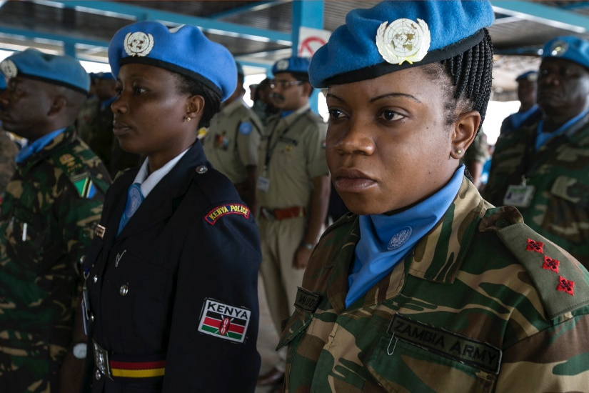
Concept of Operations
Outlines key security objectives, requirements and tasks for military and police components
Separate CONOPS for military and police
UN Core Pre-Deployment Training Materials 2016

Slide 14
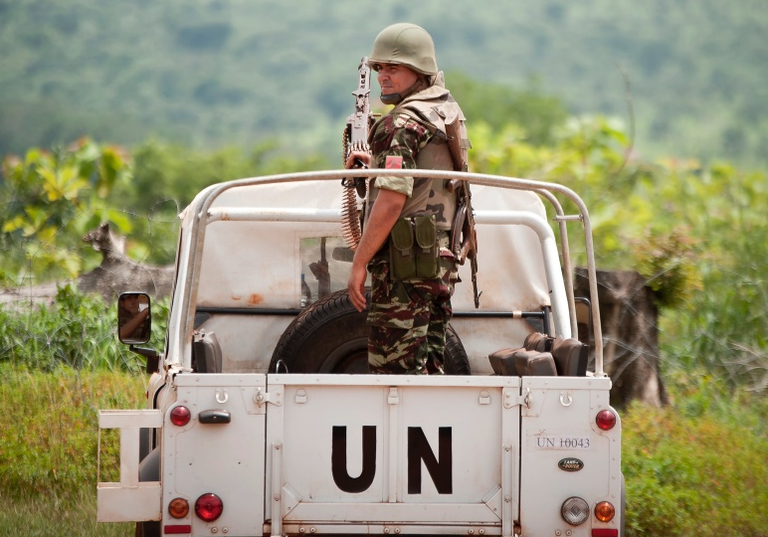
Rules of Engagement & Directive on Use of Force
Guide use of force
ROE for military component; DUF for police component
Guidance in accordance with mandate, UN Charter, international law
UN Core Pre-Deployment Training Materials 2016

Slide 15
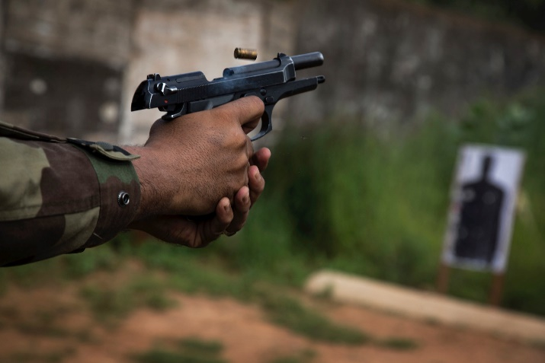
Rules of Engagement & Directive on Use of Force: The Importance
Use of force specific to mission and its mandate
Robust for volatile and potentially dangerous environments
Differs from national legal restrictions
UN Core Pre-Deployment Training Materials 2016

Slide 16
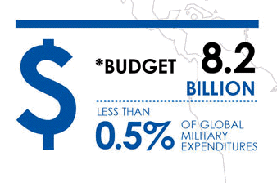
Results-Based Budgeting
The budget process by PKOs to:
  Get resources for activities
  Measure performance
UN Core Pre-Deployment Training Materials 2016

Slide 17
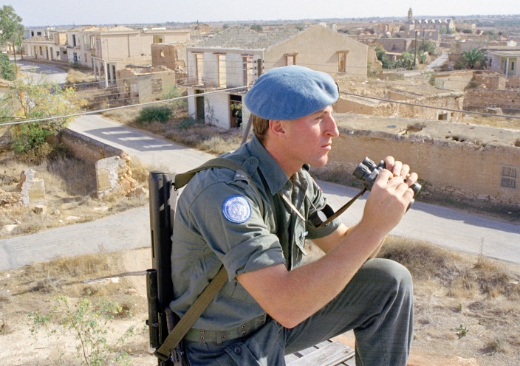
Monitoring the Mandate
SC monitors implementation of mandate through regular reports
Secretary-General submits reports to SC regarding country’s situation
Reports used to adjust, change, assess completion of mandate
UN Core Pre-Deployment Training Materials 2016

Slide 18
Completion of the Mandate
“Benchmarks” or “indicators for success” define successful completion of mandate
No standard “checklist” of benchmarks
Appropriate benchmarks adapted to each situation
UN Core Pre-Deployment Training Materials 2016

Slide 19
Summary of Key Messages
Why peacekeeping personnel must know the mandate
How SC monitors mandate implementation
Key documents that “operationalize” SC mandates
Why all armed UN peacekeeping personnel must know ROE or DUF
UN Core Pre-Deployment Training Materials 2016

Slide 20
Questions
UN Core Pre-Deployment Training Materials 2016

Slide 21
Learning Activity
Learning Evaluation
UN Core Pre-Deployment Training Materials 2016

