Slide 1
Module 2: Mandated Tasks of United Nations Peacekeeping Operations
Lesson
2.2
Peacebuilding Activities

Slide 2
Aim
To provide details on peacebuilding activities which are mandated to UN peacekeeping operations by the Security Council.
UN Core Pre-Deployment Training Materials 2016

Slide 3
Relevance
Peacekeeping missions are temporary
Peacekeeping personnel are early peacebuilders
UN Core Pre-Deployment Training Materials 2016

Slide 4
Learning Outcomes
Learners will:
List examples of mandated tasks which are peacebuilding activities
Describe peacebuilding activities
Identify different roles of mission components in peacebuilding activities
UN Core Pre-Deployment Training Materials 2016

Slide 5
Learning Overview
Overview of Peacebuilding Activities
Mine Action
Disarmament, Demobilization and Reintegration of Ex-Combatants
Security Sector Reform
Rule of Law-Related Activities
Electoral Assistance
Support to the Restoration and Extension of State Authority
UN Core Pre-Deployment Training Materials 2016

Slide 6
Overview of Peacebuilding Activities
Mine Action
Disarmament, Demobilization and Reintegration (DDR)
Security Sector Reform (SSR)
Rule of Law (ROL)-related activities
Human rights – protection and promotion
Electoral assistance
Support to the restoration and extension of state authority
UN Core Pre-Deployment Training Materials 2016

Slide 7
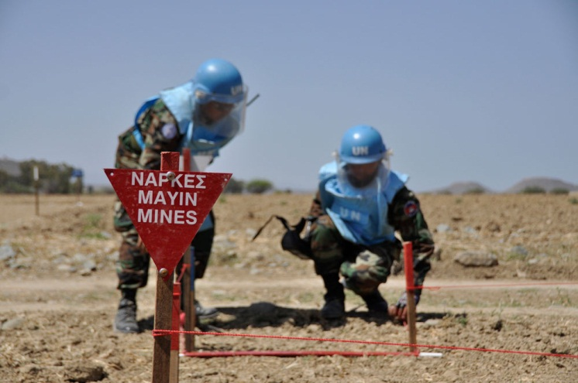
Mine Action
To reduce the threat and impact of landmines and explosive remnants of war
Five pillars:
Clearance
Risk education
Victim assistance
Stockpile destruction
Advocacy
UN Core Pre-Deployment Training Materials 2016

Slide 8
Mine Action
United Nations Mine Action Service (UNMAS)
UN peacekeeping operations (PKOs) integrate mine action
UN Core Pre-Deployment Training Materials 2016

Slide 9
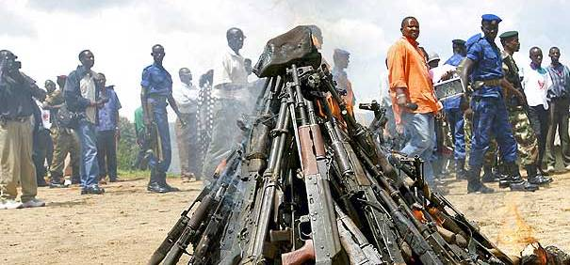
Disarmament, Demobilization and Reintegration (DDR)
UN PKO contributes to UN system efforts:
Enable development of national DDR programmes
Provide technical advice
Secure disarmament and cantonment sites
Collect and destroy weapons
UN Core Pre-Deployment Training Materials 2016

Slide 10
Security Sector Reform
State
National Security and Justice Sector
Police
Border Security
Prisons
Non-State Security Providers
Defence (DSR)
Civil Society
Parliament/Ministries
Judiciary
Other
Security and Justice Needs
PEOPLE
UN Core Pre-Deployment Training Materials 2016

Slide 11
Security Sector Reform
UN PKO:
Facilitate national SSR dialogues
Develop national security policies, strategies, plans
Strengthen oversight, management, coordination
Prepare legislation
Mobilize resources, harmonize support
Education, training, institution building
Monitor and evaluate
Defence sector reform
UN Core Pre-Deployment Training Materials 2016

Slide 12
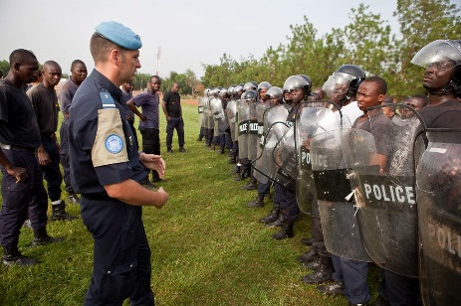
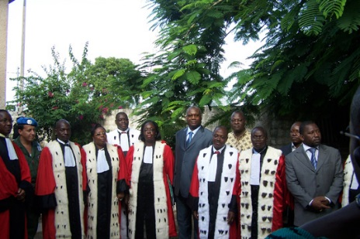
Rule of Law (ROL)-Related Activities
ROL: Legal and political framework under which all persons and institutions, including state, are accountable
Laws are:
Publicly promulgated
Equally enforced
Independently adjudicated
Consistent with IHRL
UN Core Pre-Deployment Training Materials 2016

Slide 13
Rule of Law (ROL)-Related Activities
UN PKO:
Comprehensive plans include building police stations, court houses, prisons
Develop local capacity, human resources
Oversee rehabilitation of training centres, universities
UN Core Pre-Deployment Training Materials 2016

Slide 14
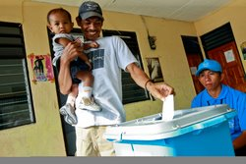
Electoral Assistance
Legal, technical, logistic support to electoral laws, processes and institutions
Technical assistance
Election observation, other assessments
Organization or supervision of elections
UN Core Pre-Deployment Training Materials 2016

Slide 15
Electoral Assistance
Department of Political Affairs’ (DPA) Electoral Assistance Division
Collaborates with UN PKO and UNCT
UN Core Pre-Deployment Training Materials 2016

Slide 16
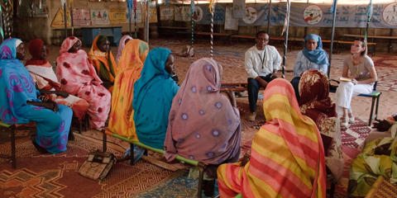
Support to the Restoration and Extension of State Authority
Rebuilding legitimacy and people’s confidence in state institutions
UN Core Pre-Deployment Training Materials 2016

Slide 17
Support to the Restoration and Extension of State Authority
Civil Affairs Officers of UN PKO:
Develop accountability, transparency
Preliminary assessments of needs
Monitor delivery of public services
Local civic education, sensitization
Logistical, administrative support
Capacity-building of local people
Support to policy, planning, decision-making
Mobilization of donor interest
UN Core Pre-Deployment Training Materials 2016

Slide 18
Summary of Key Messages
Examples of mandated tasks which are peacebuilding activities
Details of peacebuilding activities
Different roles of mission components in peacebuilding activities
UN Core Pre-Deployment Training Materials 2016

Slide 19
Questions
UN Core Pre-Deployment Training Materials 2016

Slide 20
Learning Activity
Learning Evaluation
UN Core Pre-Deployment Training Materials 2016

