Slide 1
Module 3: Individual Peacekeeping Personnel
Lesson
3.10
HIV/AIDS

Slide 2
Aim
To give peacekeeping personnel basic knowledge of HIV so they can protect themselves and others from HIV infection.
UN Core Pre-Deployment Training Materials 2016

Slide 3
Relevance
HIV education is important to:
Protect your health
Protect health of others
Protect legitimacy of mission
UN Core Pre-Deployment Training Materials 2016

Slide 4
Learning Outcomes
Learners will:
Explain HIV/AIDS and how it is transmitted
Explain how to prevent transmission of HIV
Explain what to do when exposed to HIV
Explain what to do if you have HIV
UN Core Pre-Deployment Training Materials 2016

Slide 5
Learning Overview
HIV/AIDS
HIV Transmission
How is HIV Not Transmitted
Preventing Transmission of HIV
HIV Testing
Dealing with Exposure to HIV
Living with HIV
UN Core Pre-Deployment Training Materials 2016

Slide 6
What is HIV?
H = Human
I = Immunodeficiency
V = Virus
HIV = a virus that causes the weakening of the human defence system against diseases
UN Core Pre-Deployment Training Materials 2016

Slide 7
What is AIDS?
A = Acquired | Virus has been received from another infected person
I = Immune | The body’s defence system against disease
D = Deficiency | Not working properly – the immune system is weak
S = Syndrome | Collection of symptoms associated with a particular disease
UN Core Pre-Deployment Training Materials 2016

Slide 8
How is HIV Transmitted?
Sexual contact with an infected person’s semen or vaginal fluids
Contact with HIV-infected blood
Transmission from an HIV-infected mother to her child
UN Core Pre-Deployment Training Materials 2016

Slide 9
How is HIV Not Transmitted?
Not transmitted by casual (non-sexual) interaction, e.g. shaking hands, touching and hugging or eating food prepared by someone with HIV
There are no documented cases of HIV transmission through saliva
UN Core Pre-Deployment Training Materials 2016

Slide 10
How do I Prevent HIV Transmission?
Through sexual contact? Use condoms correctly and consistently Reduce number of sexual partners Know your own and your partner’s HIV status and maintain a monogamous relationship Abstinence is the only method that is 100% effective! Through blood exposure? Do not share or use non-sterile hypodermic needles When assisting injured persons use PEP Ensure a safe blood supply is available From mother to child? Seek medical advice from a health care professional early in the pregnancy
UN Core Pre-Deployment Training Materials 2016

Slide 11
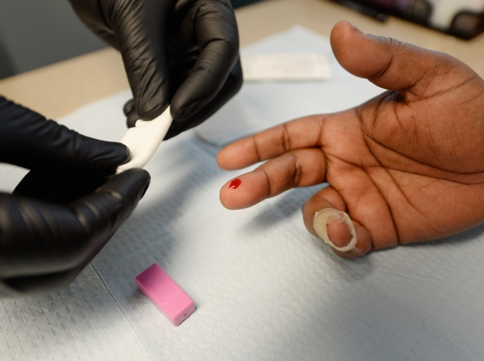
How do I know if I have HIV?
Confidential voluntary testing is available in all peacekeeping missions
UN Core Pre-Deployment Training Materials 2016

Slide 12
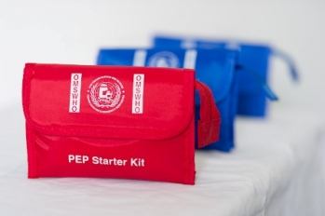
What Do I Do if Exposed to HIV?
Post Exposure Prophylaxis (PEP) treatment
Not a preventative treatment – emergency only!
Initiate as soon as possible after exposure
May not be effective over 72 hours
If exposed, IMMEDIATELY seek medical assistance
UN Core Pre-Deployment Training Materials 2016

Slide 13
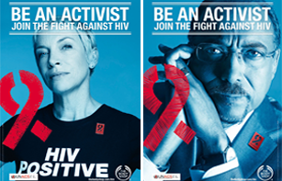
What Do I Do if I Am HIV(+)?
Anyone can become infected with the virus!
Seek the advice of a healthcare professional
Early detection and treatment are key to staying healthy
UN Core Pre-Deployment Training Materials 2016

Slide 14
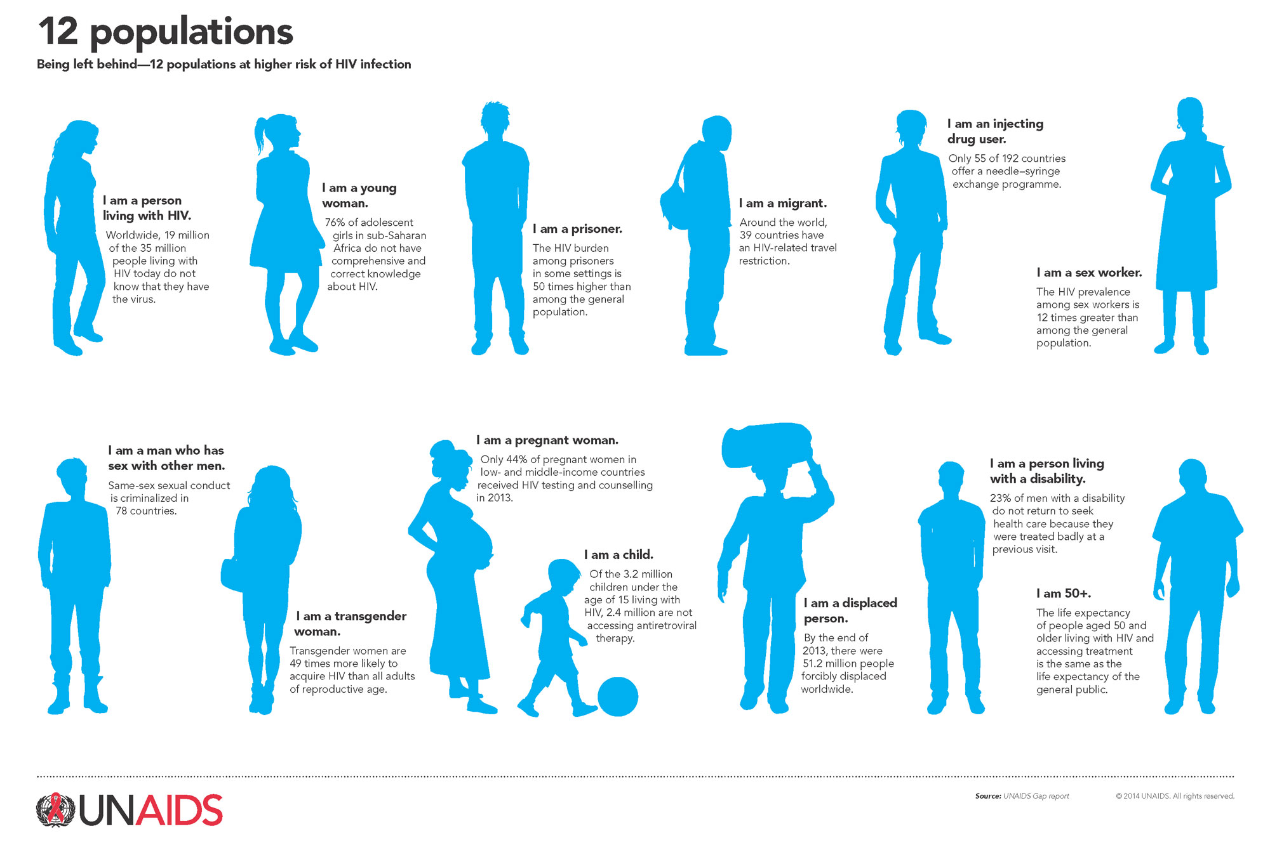
UN Core Pre-Deployment Training Materials 2016

Slide 15
Summary of Key Messages
HIV/AIDS and how transmitted
How to prevent transmission of HIV
What to do when exposed to HIV
What to do if you have HIV
UN Core Pre-Deployment Training Materials 2016

Slide 16
Questions
UN Core Pre-Deployment Training Materials 2016

Slide 17
Learning Activity
Learning Evaluation
UN Core Pre-Deployment Training Materials 2016

