Slide 1
Module 3: Individual Peacekeeping Personnel
Lesson
3.3
Conduct and Discipline

Slide 2
Aim
To brief peacekeeping personnel on UN:
Norms of conduct
Consequences for misconduct
Duties and responsibilities to report misconduct
UN Core Pre-Deployment Training Materials 2016

Slide 3
Relevance
Peacekeeping personnel:
Ambassadors of the UN
Highest standards of behaviour and integrity
No sexual violence or exploitation
UN Core Pre-Deployment Training Materials 2016

Slide 4
Learning Outcomes
Learners will:
List three key principles of conduct
Describe categories of misconduct
Explain consequences of misconduct for peacekeeping personnel, host population and mission
List key entities addressing conduct and discipline
UN Core Pre-Deployment Training Materials 2016

Slide 5
Learning Overview
Standards of Conduct Matter
UN Standards of Conduct
Immunities and Privileges
Misconduct
Consequences of Misconduct
Reporting and Investigation of Misconduct
Responsibility for Conduct
Built on Core Values and Competencies
UN Core Pre-Deployment Training Materials 2016

Slide 6
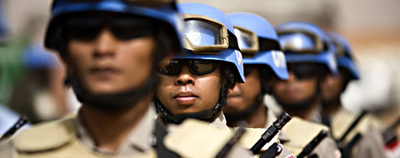
Standards of Conduct Matter
Your conduct represents the UN
You should not hinder or jeopardize the mandate
You should not become a safety and security risk
UN Core Pre-Deployment Training Materials 2016

Slide 7
UN Standards of Conduct
Three principles underpin UN standards of conduct. They are based on UN Core Values and competencies:
Highest standards of efficiency, competence and integrity
Zero tolerance policy on sexual exploitation and abuse
Accountability of those in command or authority who fail to enforce the standards of conduct
UN Core Pre-Deployment Training Materials 2016

Slide 8
Sources for Civilians
For Civilian Staff (including UN staff members, UNVs, consultants and contractors)
UN Charter UN Staff Regulations and Rules UN Financial Regulations and Rules Status, basic rights and duties of UN staff members (ST/SGB/2002/13) Measures for protection from sexual exploitation and sexual abuse (ST/SGB/2003/13) Prohibition of discrimination, harassment, including sexual harassment and abuse of authority (ST/SGB/2008/5) Other Administrative issuances, including on the use of information and communication technology (e.g. pornography, gambling) SOFA/SOMA
UN Core Pre-Deployment Training Materials 2016

Slide 9
Sources for Police and Military
For Uniformed Personnel
UN Charter Revised draft model Memorandum of Understanding between the UN and Troop Contributing Countries incorporating the annex “We are the UN Peacekeeping Personnel” Status, basic rights and duties of officials other than Secretariat and experts on mission (ST/SGB/2002/9) Measures for protection from sexual exploitation and sexual abuse (ST/SGB/2003/13) Observance by United Nations forces of International Humanitarian Law (ST/SGB/1999/13) Directives for Disciplinary Matters involving Civilian Police Officers and Military Observers (DPKO/MD/03/00994) Ten Rules/Code of Personal Conduct for Blue Helmets Other Administrative issuances, including use of information and communication technology (e.g. pornography, gambling)
UN Core Pre-Deployment Training Materials 2016

Slide 10
Code of Conduct for Peacekeeping Personnel
The UN Charter requires that all personnel must maintain the highest standards of integrity and conduct
All personnel will comply with the Guidelines on International Humanitarian Law for Forces Undertaking United Nations Peacekeeping Operations and the applicable portions of the Universal Declaration of Human Rights as the fundamental basis of our standards
All personnel must be prepared to accept special constraints in their public and private lives in order to do the work and to pursue the ideals of the UN Organization
UN Core Pre-Deployment Training Materials 2016

Slide 11
Immunities and Privileges
Exist in Inernational Law to enable civilian and police personnel as well as military observers to perform their functions
May be waived by the Secretary-General when in the interests of the UN
Does not mean that peacekeeping personnel who violate standards of conduct will get away with it
UN Core Pre-Deployment Training Materials 2016

Slide 12
Misconduct
Definition of Misconduct
Defined differently for different categories of peacekeeping personnel
All build on the same three principles of the UN standards of conduct
UN Core Pre-Deployment Training Materials 2016

Slide 13
Definition of Misconduct
For Civilian Personnel
Failure by a staff member to: Comply with his/her obligations under UN Charter, Staff Regulations and Rules and relevant Administrative issuances Observe Standards of Conduct expected of an international civil servant Reference: Staff Rule 310.1 Principles are also binding on other civilians in peacekeeping missions
UN Core Pre-Deployment Training Materials 2016

Slide 14
Definition of Misconduct
For Members of National Contingent and Military Staff Officers
Misconduct means any act or omission that is a violation of UN standards of conduct, mission-specific rules and regulations or the obligations towards national and local laws and regulations in accordance with the status-of-forces agreement where the impact is outside the national contingent. Serious Misconduct is misconduct, including criminal acts, that results in, or is likely to result in serious loss, damage or injury to an individual or to a mission. Sexual exploitation and abuse constitute serious misconduct. Reference: We are the UN Peacekeeping Personnel (lists specific instances)
UN Core Pre-Deployment Training Materials 2016

Slide 15
Definition of Misconduct
For UN Police and Military Observers
Minor Misconduct: any act, omission or negligence that is a violation of mission standard operating procedures (SOPs), directives or any other applicable rules, regulations or administrative instructions, but which does not result in or is not likely to result in major damage or injury to an individual or the mission. Serious Misconduct: any act, omission or negligence, including criminal acts, that is a violation of mission SOPs, directives or any other applicable rules, regulations or administrative instructions, that results in or is likely to result in serious damage or injury to an individual or to the mission. Reference: Directives for Disciplinary Matters involving Civilian Police Officers and Military Observers (lists specific instances)
UN Core Pre-Deployment Training Materials 2016

Slide 16
Categories of Misconduct
Category I: Serious Misconduct includes:
Sexual exploitation and abuse (SEA)
Criminal activities, e.g. offences against the person, offences against property, including fraud
Category II: Misconduct includes:
Simple theft and fraud
Sexual or other work-related harassment
Traffic-related incidents, e.g. speeding
UN Core Pre-Deployment Training Materials 2016

Slide 17
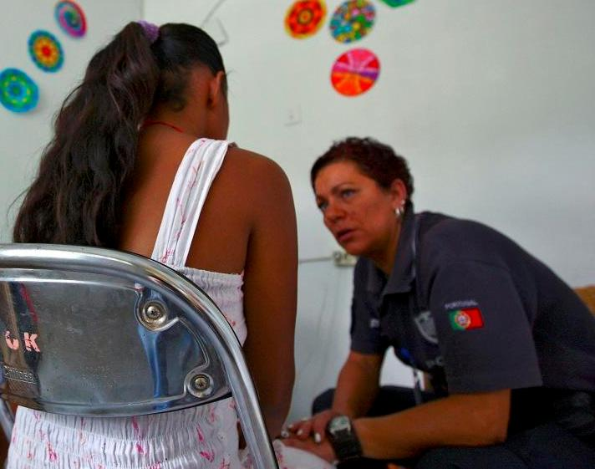
Consequences of Misconduct
For the Victim
Violates victim’s human rights
May negatively impact Safety, Security and Property
UN Core Pre-Deployment Training Materials 2016

Slide 18
For the Mission
Violates human rights
Misconduct contrary to UN principles
Violates integrity and impartiality
Reduces credibility and image of UN
Threatens security
Undermines rule of law and fosters crime
UN Core Pre-Deployment Training Materials 2016

Slide 19
For Peacekeeping Personnel
Disciplinary action
Repatriation/barring from future service
Summary dismissal
Criminal proceedings
Financial liability
UN Core Pre-Deployment Training Materials 2016

Slide 20
Reporting and Investigation
Key Entities
Conduct and Discipline Unit
Office of the Internal Oversight Services (OIOS)
Ethics Office
UN Ombudsman
UN Core Pre-Deployment Training Materials 2016

Slide 21
Investigations
Category I: Investigation by OIOS
Sexual exploitation and abuse (SEA)
Criminal activities, e.g. offences against person or property, including fraud
Category II: Investigation by Responsible Official
Simple theft and fraud
Sexual or other work-related harassment
Traffic-related incidents, e.g. speeding
UN Core Pre-Deployment Training Materials 2016

Slide 22
Duties
Report suspected misconduct
Report in good faith supported by evidence
Cooperate with UN investigations
Make reports to UN officials, OIOS or to others in special circumstances
Report misconduct directly to OIOS without a need for supervisory approval (ST/SGB/273, para 18)
UN Core Pre-Deployment Training Materials 2016

Slide 23
Protection from Retaliation
Retaliation: direct or indirect detrimental action recommended, threatened or taken against a person who reports misconduct.
Retaliation for reporting misconduct or cooperating with an investigation is prohibited.
As per OIOS mandate (ST/SGB/273, para 18 (f)), no action may be taken against staff who make reports or cooperate with OIOS. Disciplinary action shall be initiated if retaliatory action is taken or as a reprisal.
Retaliation can be reported.
UN Core Pre-Deployment Training Materials 2016

Slide 24
Who is Responsible?
Individual Responsibility
Each peacekeeper is an ambassador
Be familiar and comply with human rights, IHL and the specific rules, regulations and guidance provided by the UN guide to conduct
You have a duty to report misconduct, cooperate in investigations and provide information in good faith
UN Core Pre-Deployment Training Materials 2016

Slide 25
Leadership and Accountability
Maintain standards of conduct
Prevent, monitor and respond to misconduct
Ensure misconduct prevention training
Conduct periodic misconduct risk assessments
Report all misconduct to the Conduct and Discipline Team or OIOS
UN Core Pre-Deployment Training Materials 2016

Slide 26
Summary of Key Messages
Three key principles of conduct
Categories of misconduct
Consequences of misconduct for peacekeeping personnel, host population and mission
Key entities addressing conduct and discipline
UN Core Pre-Deployment Training Materials 2016

Slide 27
Questions
UN Core Pre-Deployment Training Materials 2016

Slide 28
Learning Activity
Learning Evaluation
UN Core Pre-Deployment Training Materials 2016

