Slide 1
Module 2: Mandated Tasks of United Nations Peacekeeping Operations
Lesson
2.7
Child Protection

Slide 2
Aim
To explain obligations of peacekeeping personnel for child protection as part of the mission mandate.
UN Core Pre-Deployment Training Materials 2016

Slide 3
Relevance
Peacekeeping personnel:
Protect children’s human rights
Protect children from violence
UN Core Pre-Deployment Training Materials 2016

Slide 4
Learning Outcomes
Learners will:
Define a “child”
Explain why children need special protection, especially in conflict
Describe duties of peacekeeping personnel as reflected in UN policies
Describe role and responsibilities of individual peacekeeping personnel
UN Core Pre-Deployment Training Materials 2016

Slide 5
Learning Overview
Definitions
Special Protection for Children in Armed Conflict
Six Grave Violations against Children’s Rights in Armed Conflict
UN Leads in Children and Armed Conflict
Legal Framework for the Protection of Children in Armed Conflict
DPKO/DFS Policies on Child Protection
Child Protection in UN Peacekeeping
Roles and Responsibilities
Coordination with Partners
What Individual Peacekeeping Personnel Can Do
UN Core Pre-Deployment Training Materials 2016

Slide 6
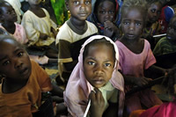
Definitions
A child is every boy or girl under the age of 18
The aim of Child Protection is to protect children from violence, abuse and neglect and promote their rights
UN Core Pre-Deployment Training Materials 2016

Slide 7
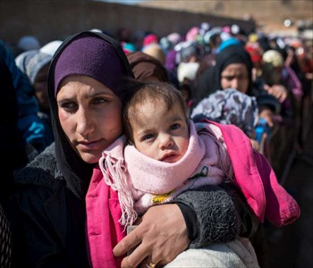
Importance of Special Protection for
Children in Armed Conflict
Easily influenced
Depend on structures for protection care
Process of growing up
UN Core Pre-Deployment Training Materials 2016

Slide 8
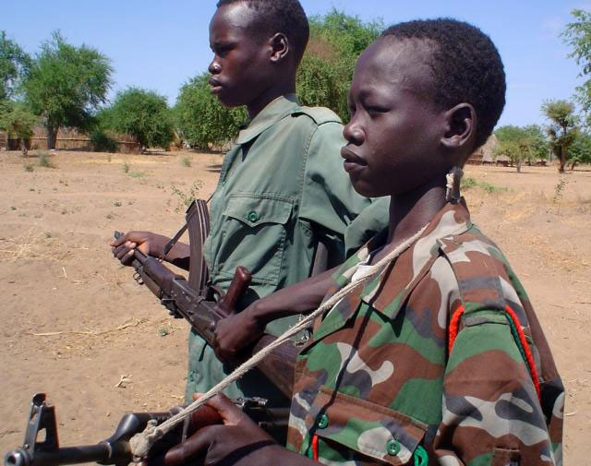
Six Grave Violations against Children’s Rights in Situations of Armed Conflict
Killing and maiming
Recruitment and use of children
Abduction
Rape and sexual violence
Attacks against schools and hospitals
Denial of humanitarian access
UN Core Pre-Deployment Training Materials 2016

Slide 9
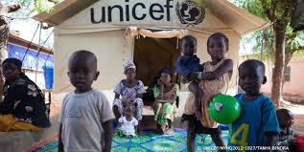
UN Actors Leading in
Children and Armed Conflict
Office of the Special Representative of the Secretary-General for Children and Armed Conflict (OSRSG-CAAC)
The United Nations Children’s Fund
UN Core Pre-Deployment Training Materials 2016

Slide 10
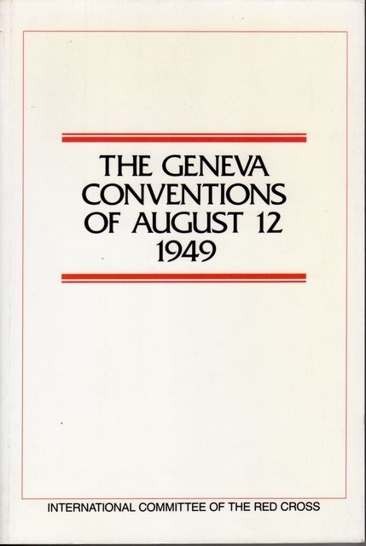
Legal Framework for Protection of
Children in Armed Conflict
IHL
Convention on the Rights of the Child
(CRC, 1989)
Optional Protocol to the Convention on
the Rights of the Child on the
Involvement of children in armed
conflict (OPAC, 2000)
The International Labour Organization
(ILO) Convention 182 (1999)
Rome Statute of the International
Criminal Court (ICC, 1998)
Mine Ban Treaty of 1997 and
Convention on Cluster Munitions (2008)
UN Core Pre-Deployment Training Materials 2016

Slide 11
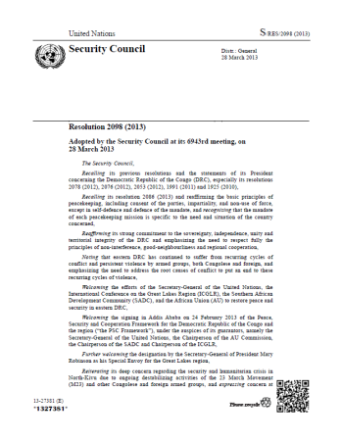
Legal Framework for Protection of
Children in Armed Conflict
Security Council resolutions on Children and Armed Conflict – 1612 (2005) on Monitoring and Reporting Mechanism (MRM)
Security Council mandate
UN Core Pre-Deployment Training Materials 2016

Slide 12
DPKO/DFS Policies on Child Protection
DPKO/DFS Policy on Mainstreaming Child Protection (2009) “DPKO shall ensure that the concerns of protection, rights and well-being of children affected by armed conflict are specifically integrated into all aspects of UN peacekeeping”. | DPKO Policy on the Prohibition of Child Labour in UN Peacekeeping Missions (2012) “the use of children under the age of 18 for the purpose of labour or rendering of services by UN peacekeeping operations is strictly prohibited”.
UN Core Pre-Deployment Training Materials 2016

Slide 13
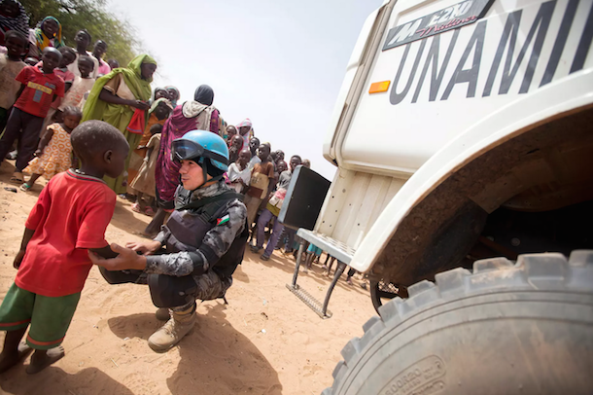
Child Protection in UN Peacekeeping
Alert for six grave violations
Alert to other violations:
Illegal arrest, detention
Forced displacement
Trafficking for sexual exploitation, domestic labour
Record and refer to child protection, human rights experts
UN Core Pre-Deployment Training Materials 2016

Slide 14
Roles and Responsibilities
Child Protection Adviser
Placing the concerns of children onto peace and political agenda
Mainstreaming, advising, training, advocating child protection
Monitoring and reporting grave violations against children
Liaising with UNICEF and other child protection actors for follow-up and response
Child Protection
Goal
UN Core Pre-Deployment Training Materials 2016

Slide 15
Other Units
DDR
Human Rights
Political Affairs
Gender Adviser
Women Protection Adviser
Civil Affairs
Rule of Law
Judicial Affairs
Corrections
Security Sector Reform
Electoral
Mission Support
SRSG’s Office
UN Core Pre-Deployment Training Materials 2016

Slide 16
Other Mission Components:
Special Roles of the Police
Mentoring and advising
Vetting, training and advising
Investigating
Reporting
Child Protection
Goal
UN Core Pre-Deployment Training Materials 2016

Slide 17
Other Mission Components:
Special Roles of the Military
Protection
Contributing to alerts and information related to child rights violations
Identify and release children from armed groups
Child Protection
Goal
UN Core Pre-Deployment Training Materials 2016

Slide 18
Coordination with Other Partners
Child Protection Advisers coordinate with:
UNICEF
Other UN agencies – UNHCR, ILO, UNESCO, UNFPA
International and national NGOs
National ministries – social, health, education, youth and inter-agency groups
UN Core Pre-Deployment Training Materials 2016

Slide 19
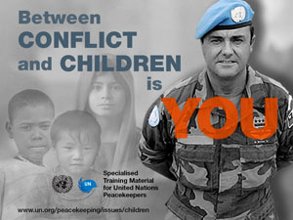
What Individual Peacekeeping Personnel Can Do
UN Core Pre-Deployment Training Materials 2016

Slide 20
What Individual Peacekeeping Personnel Can Do
Identify and be alert – Six Grave Violations
Record essential information
Do not interview
Report to CPA or other experts
UN Core Pre-Deployment Training Materials 2016

Slide 21
What Individual Peacekeeping Personnel Can Do
Dos | Don’ts
Report misconduct | Use children for any services
Keep information confidential | Interview children
Refer child survivors of violations | Take pictures of child survivors of violations
Ask CPA or CDU for guidance, if needed | Give money, food or other products to children
UN Core Pre-Deployment Training Materials 2016

Slide 22
Summary of Key Messages
Define a “child”
Why children need special protection, especially in conflict
Duties of peacekeeping personnel as reflected in UN policies
Role and responsibilities of individual peacekeeping personnel
UN Core Pre-Deployment Training Materials 2016

Slide 23
Questions
UN Core Pre-Deployment Training Materials 2016

Slide 24
Learning Activity
Learning Evaluation
UN Core Pre-Deployment Training Materials 2016

