Slide 1
Module 2: Mandated Tasks of United Nations Peacekeeping Operations
Lesson
2.3
Protection of Human Rights

Slide 2
Aim
To increase ability of peacekeeping personnel to promote human rights in everyday tasks.
UN Core Pre-Deployment Training Materials 2016

Slide 3
Relevance
Peacekeeping personnel must:
Recognize and respond to human rights violations/abuses
Protect and promote human rights
UN Core Pre-Deployment Training Materials 2016

Slide 4
Learning Outcomes
Learners will:
Identify human rights violations/abuses
Explain UN policies on human rights
Identify human rights-related roles in mission
Describe coordination role of human rights unit
List actions to take when human rights violations/ abuses are observed
UN Core Pre-Deployment Training Materials 2016

Slide 5
Learning Overview
The Importance of Human Rights Protection
Human Rights, Security and Development
Violations and Abuses
UN Leads on Human Rights
Legal Framework
UN Policies on Human Rights
Human Rights in UN Peacekeeping
Roles and Responsibilities
What Individual Peacekeeping Personnel Can Do
UN Core Pre-Deployment Training Materials 2016

Slide 6
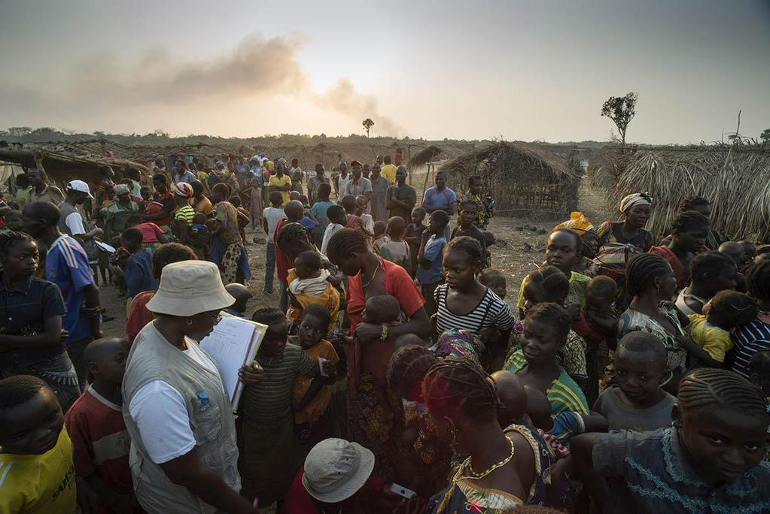
The Importance of Human Rights Protection
Human rights – a core pillar of the UN
UN Core Pre-Deployment Training Materials 2016

Slide 7
Human Rights, Security and Development
“We will not enjoy development without security, we will not enjoy security without development and we will not enjoy either without respect for human rights”.
UN Core Pre-Deployment Training Materials 2016

Slide 8
Links with Cross-Cutting Thematic Tasks
Protection of civilians (POC)
Conflict-related sexual violence (CRSV)
Child protection
Women peace and security (WPS)
UN Core Pre-Deployment Training Materials 2016

Slide 9
Violations and Abuses
Human rights violation: action/inaction of state official or agent – police, soldier, judge, local administrator, parliamentarian
Human rights abuse: committed by non-state actors – rebel groups, corporations, individuals
UN Core Pre-Deployment Training Materials 2016

Slide 10
UN Leads in Human Rights
Office of the High Commissioner for Human Rights (OHCHR)
UN Core Pre-Deployment Training Materials 2016

Slide 11
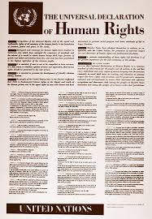
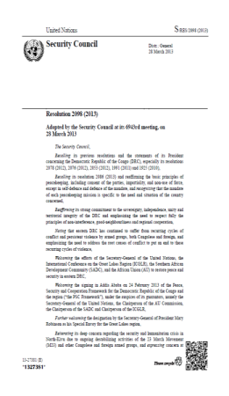
Legal Framework for promotion and protection of Human Rights in UN PKO
UN Charter
The International Human Rights Law
Security Council resolutions
UN Core Pre-Deployment Training Materials 2016

Slide 12
UN Policies on Human Rights
“Human Rights Up Front” (HRuF) Initiative (2012)
UN Policy on Human Rights in UN Peace Operations & Political Missions (2011)
UN Policy on Human Rights Screening of UN Personnel (2012)
Human Rights Due Diligence Policy on UN Support to Non-UN Security Forces (2011)
UN Core Pre-Deployment Training Materials 2016

Slide 13
Human Rights in UN Peacekeeping
Integrate into every day work
Support national capacity
UN Core Pre-Deployment Training Materials 2016

Slide 14
Roles and Responsibilities
Human Rights Unit
Monitor and investigate human rights violations/abuses
Produce internal and public reports
Advocacy and intervention
Strengthen national/local capacity
Coordination and mainstreaming in PKO, UNCT and Humanitarian Country Team
Protection
Empowerment
Goal
UN Core Pre-Deployment Training Materials 2016

Slide 15
Other Units
Rule of Law/Judicial Affairs
Corrections
Gender Adviser
Women Protection Adviser
Child Protection
Protection of Civilians
SSR
Civil Affairs
Electoral
DDR
Political Affairs
DSRSG/RC/HC
SRSG’s Office
UN Core Pre-Deployment Training Materials 2016

Slide 16
Special Roles of Police
Mentoring
Vetting, training and advising
Investigating
Reporting
Human Rights
UN Core Pre-Deployment Training Materials 2016

Slide 17
Special Roles of Military
Human Rights
Physical protection
Human rights monitoring and reporting
Supporting partners
UN Core Pre-Deployment Training Materials 2016

Slide 18
What Individual Peacekeeping
Personnel Can Do
Take note of facts
Immediately report
Protect sensitive information
Consult human rights component
Promote understanding – translators
Avoid false expectations – victims, witnesses
Appropriate intervention
Follow the situation
UN Core Pre-Deployment Training Materials 2016

Slide 19
Summary of Key Messages
Human rights violations/abuses
UN policies on human rights
Human rights-related roles in mission
Coordination role of human rights unit
Actions to take when human rights violations/ abuses are observed
UN Core Pre-Deployment Training Materials 2016

Slide 20
Questions
UN Core Pre-Deployment Training Materials 2016

Slide 21
Learning Activity
Learning Evaluation
UN Core Pre-Deployment Training Materials 2016

