Slide 1

Module 1: An Overview of United Nations Peacekeeping Operations
Lesson
1.1
United Nations Peacekeeping

Slide 2

Aim
To introduce the United Nations and its
Peacekeeping Operations
UN Core Pre-Deployment Training Materials 2016

Slide 3
Relevance
As peacekeeping personnel you:
Represent the UN
Carry out decisions made at the UN Headquarters in New York
UN Core Pre-Deployment Training Materials 2016

Slide 4
Learning Outcomes
Learners will:
Explain the UN and its purpose
Identify the UN Charter as the guiding document
List principal organs involved in peacekeeping
List departments active in peacekeeping
Describe three levels of UN peacekeeping
UN Core Pre-Deployment Training Materials 2016

Slide 5
Learning Overview
An Introduction to the UN
Principal Organs of the UN Active in Peacekeeping
Departments of the Secretariat Active in Peacekeeping
Three Levels in Peacekeeping – Strategic, Operational & Tactical
UN Core Pre-Deployment Training Materials 2016

Slide 6
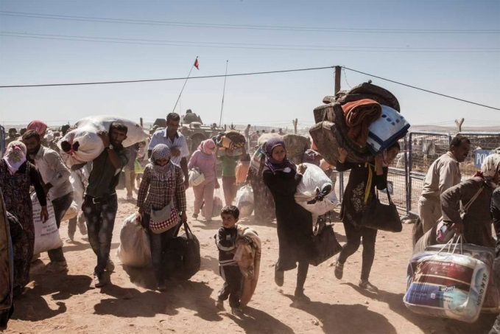

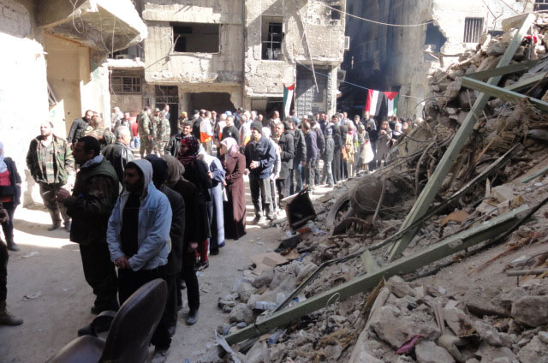
An Introduction to the UN
Violent conflict is devastating
UN Core Pre-Deployment Training Materials 2016

Slide 7
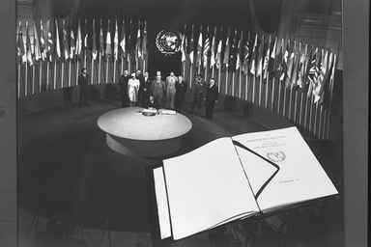
The United Nations
Founded in 1945 after World War II
“[…]to save succeeding generations from the scourge of war[…]” (Preamble of the UN-Charter)
UN Core Pre-Deployment Training Materials 2016

Slide 8
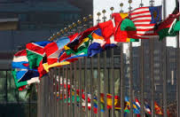
UN Member States
193 sovereign Member States
Universal and impartial international organization
UN Core Pre-Deployment Training Materials 2016

Slide 9
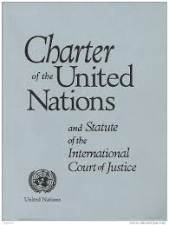
UN Charter
Founding document
Defines main purposes and principles
“Maintain international peace and security” – a main purpose
UN Core Pre-Deployment Training Materials 2016

Slide 10
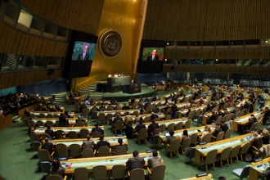
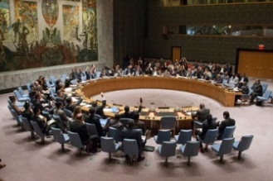
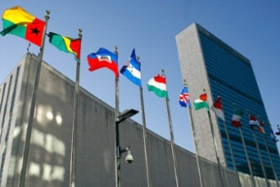
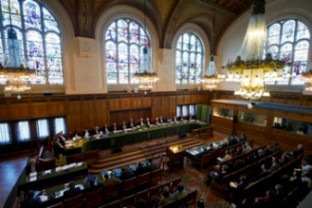
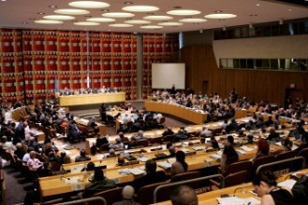
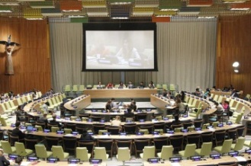
Principal Organs
General Assembly
International Court of Justice
Security Council
Economic and Social Council
Secretariat
Trusteeship Council
UN Core Pre-Deployment Training Materials 2016

Slide 11
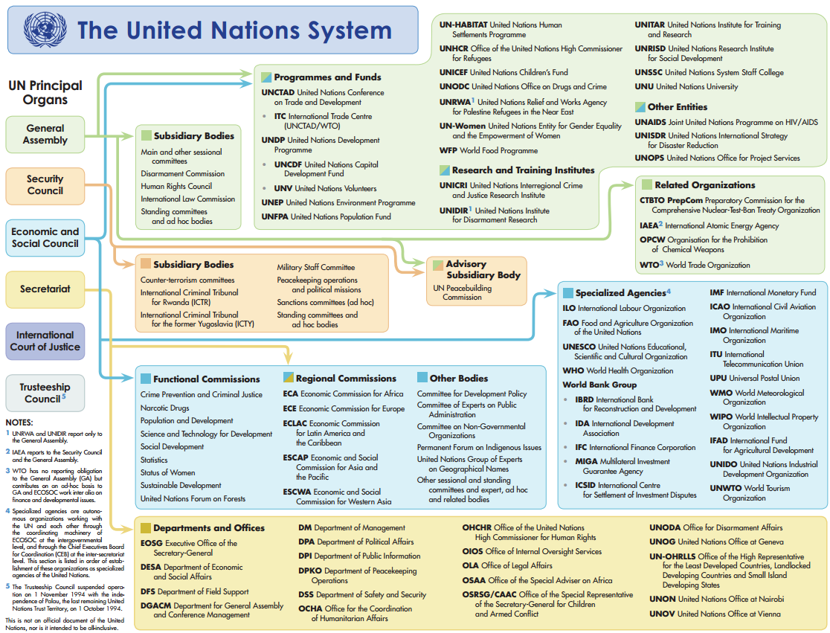
UN Specialized Agencies, Funds & Programmes
UN Core Pre-Deployment Training Materials 2016

Slide 12
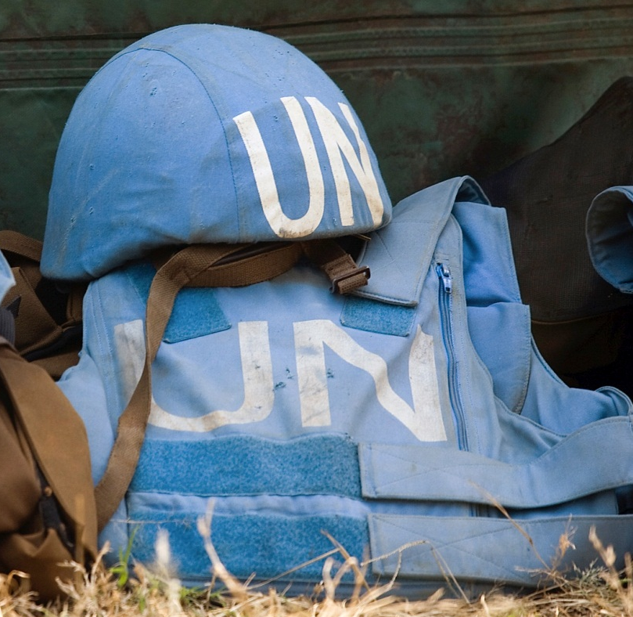
Principal UN Organs
Active in Peacekeeping
General Assembly
Security Council
Secretariat
UN Core Pre-Deployment Training Materials 2016

Slide 13
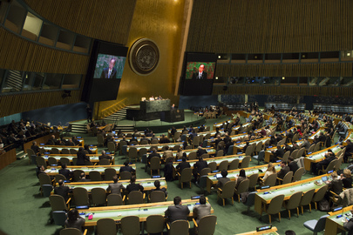
General Assembly
General Assembly
Main forum for Member States to make decisions
Committees, e.g. C-34
UN Core Pre-Deployment Training Materials 2016
8

Slide 14
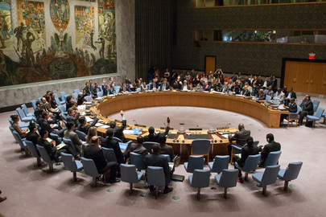
Security Council
Security Council
Primary responsibility for maintaining international peace and security
Power to investigate threats and take appropriate measures
UN Core Pre-Deployment Training Materials 2016

Slide 15
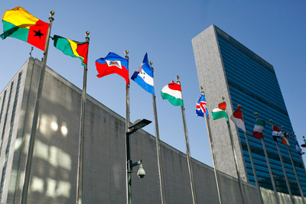
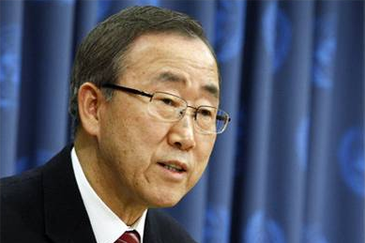
Secretariat
Secretariat
Secretariat:
led by Secretary-General
Secretary-General: “Chief Administrative Officer” of the Organization
UN Core Pre-Deployment Training Materials 2016
10

Slide 16
Secretariat Departments
Active in Peacekeeping
Security Council
Secretary-General
Secretariat
USG DFS
USG DPKO
USG DPA
DFS
DPKO
DPA
UN Core Pre-Deployment Training Materials 2016

Slide 17
Department of Peacekeeping Operations
Executive direction of peacekeeping operations
Security Council
Secretary-General
Secretariat
USG DFS
USG DPKO
USG DPA
DFS
DPKO
DPA
UN Core Pre-Deployment Training Materials 2016
12

Slide 18
Department of Field Support
Delivers support to UN field missions
Finance, personnel, administration, information and communication technology, logistics
Security Council
Secretary-General
Secretariat
USG DFS
USG DPKO
USG DPA
DFS
DPKO
DPA
UN Core Pre-Deployment Training Materials 2016
13

Slide 19
Department of Political Affairs
Substantive direction to Special Political Missions
Collaborates with peacekeeping missions – political analysis, electoral assistance
Security Council
Secretary-General
Secretariat
USG DFS
USG DPKO
USG DPA
DFS
DPKO
DPA
UN Core Pre-Deployment Training Materials 2016

Slide 20
The Strategic, Operational & Tactical
Levels in Peacekeeping
General Assembly
Security Council
Secretary-General
Strategic
Secretariat
(DPKO, DFS, DPA)
Head of Mission
Mission Headquarters & Leadership Team
Operational
Component Heads
Civilian Units
Tactical
Military Units
Police Units
Regional Offices
UN Core Pre-Deployment Training Materials 2016

Slide 21
UN-Specific Terms of Use
(As defined in DPKO/DFS Policies)
Strategic
  High level political decision-making and management of a UN peacekeeping operation at UN HQ
Operational
  Field-based management of a peacekeeping operation at Mission HQ
Tactical
  Management of military, police and civilian operations below the level of Mission HQ
  Supervision of individual personnel
  Exercised at various levels by subordinate commanders of specific components and civilian heads at levels below the Mission HQ
UN Core Pre-Deployment Training Materials 2016

Slide 22
Summary of Key Messages
UN and its purpose
UN Charter as the guiding document
Principal organs involved in peacekeeping
Departments active in peacekeeping
Three levels of UN peacekeeping
UN Core Pre-Deployment Training Materials 2016

Slide 23
Questions
UN Core Pre-Deployment Training Materials 2016

Slide 24
Learning Activity
Learning Evaluation
UN Core Pre-Deployment Training Materials 2016

