Slide 1

Module 1: An Overview of United Nations Peacekeeping Operations
Lesson
1. 8
Working with Mission Partners

Slide 2

Aim
To detail how implementing a peacekeeping mandate requires work with partners.
UN Core Pre-Deployment Training Materials 2016

Slide 3
Relevance
Peacekeeping personnel are expected to:
Work with the UN Country Team (UNCT)
Work with national partners – key stakeholders
Understand and support work of external partners
UN Core Pre-Deployment Training Materials 2016

Slide 4
Learning Outcomes
Learners will:
List types of mission partners and examples
Explain why the UNCT is important
Describe “integrated approach” and benefit
Explain why national partners are key partners
UN Core Pre-Deployment Training Materials 2016

Slide 5
Lesson Overview
The Importance of Mission Partners Working Together
Mission Partners
UN Partners
National Partners
External Partners
UN Core Pre-Deployment Training Materials 2016

Slide 6
The Importance of Mission Partners
Working Together
The Core Business of Multi-Dimensional UN Peacekeeping Operations
INDICATIVE POST-CONFLICT TASKS
Infrastructure
Employment
Economic governance
Civil administration
Elections
Political process
Security operations
DDR
Rule of law
Human rights
Capacity building
Humanitarian assistance
STABILIZATION
PEACE
CONSOLIDATION
LONG-TERM RECOVERY
& DEVELOPMENT
World Bank/IMF
UN Peacekeeping
UN Country Team, Donors
Local Institutions
ICRC/NGOs
UN Core Pre-Deployment Training Materials 2016

Slide 7



The Different Mission Partners
UN Partners
National Partners
External Partners
UN Core Pre-Deployment Training Materials 2016

Slide 8

UN Partners
UN Core Pre-Deployment Training Materials 2016

Slide 9


Why Important?
Knows host country and conflict situation
Relationships with national partners
Continuity for peacebuilding activities
Financial resources and expertise
UN Core Pre-Deployment Training Materials 2016

Slide 10
The Integrated Approach
UN Core Pre-Deployment Training Materials 2016

Slide 11




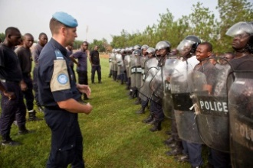
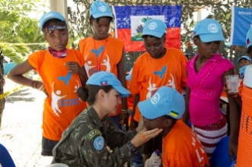

National Partners
State actors: host government, ministries, military, police
Non-state actors: civil society, non-governmental organizations, private sector
UN Core Pre-Deployment Training Materials 2016

Slide 12
Why “Key Partners”?
Have the most at stake – beneficiaries, clients
Efforts ensure host government can meet the needs of its people
Promotion of national and local ownership is a success factor
UN Core Pre-Deployment Training Materials 2016

Slide 13




The Host Government
Most important non-UN actor
Interactions on many levels
Partnerships with other state actors – national military, police
Include variety of political views and social groups
UN Core Pre-Deployment Training Materials 2016

Slide 14

Civil Society
A community of citizens linked by common interests and activities
Political parties, national NGOs and other associations, communities or groups of citizens
UN Core Pre-Deployment Training Materials 2016

Slide 15





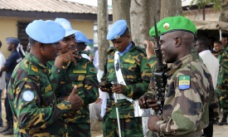
External Partners
International organizations
ICRC
Individual Member States
Intergovernmental Organizations
UN Core Pre-Deployment Training Materials 2016

Slide 16
Why is Coordination & Cooperation Important?
Large number of external partners
Separate but overlapping mandates and expertise
Independent agendas
Different timelines and work methods
UN Core Pre-Deployment Training Materials 2016

Slide 17
International Organizations
Includes NGOs with an international presence
Can provide humanitarian assistance
UN Core Pre-Deployment Training Materials 2016

Slide 18




International Committee of the Red Cross
Important humanitarian actor
Mandate: protect and assist victims of armed conflict
“International legal personality”
UN Core Pre-Deployment Training Materials 2016

Slide 19




Individual Member States
Diplomatic community
Bilateral donors
Contractors
Non-UN led military forces
UN Core Pre-Deployment Training Materials 2016

Slide 20


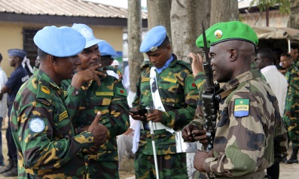
Intergovernmental Organizations
Regional and sub-regional organizations
Differing roles and relationships with the UN
Peace enforcement operations
UN Core Pre-Deployment Training Materials 2016

Slide 21
Summary of Key Messages
Types of mission partners
Why the UNCT is important
The “integrated approach” and benefit
Why national partners are key partners
UN Core Pre-Deployment Training Materials 2016

Slide 22
Questions
UN Core Pre-Deployment Training Materials 2016

Slide 23
Learning Activity
Learning Evaluation
UN Core Pre-Deployment Training Materials 2016

Slide 24
Learning Activity 1.8.3
The Integrated Approach
UN Core Pre-Deployment Training Materials 2016

Slide 25
UN Partners:
The Integrated Approach
UN Core Pre-Deployment Training Materials 2016

