Slide 1
Module 1: An Overview of United Nations Peacekeeping Operations
Lesson
1. 4
The Legal Framework for United Nations Peacekeeping

Slide 2
Aim
To explain the legal framework for UN peacekeeping operations and emphasize parts of international law important to peacekeepers
UN Core Pre-Deployment Training Materials 2016

Slide 3
Relevance
Peacekeeping personnel:
“Ambassadors” of UN
Role models, a good example
Know what you “should” and “should not” do
Must not violate International Human Rights Law (IHRL) or International Humanitarian Law (IHL)
UN Core Pre-Deployment Training Materials 2016

Slide 4
Learning Outcomes
Learners will:
List key documents in legal framework
Define human rights
List examples of human rights protected under IHRL
Identify who is protected by IHL
List essential rules of IHL
UN Core Pre-Deployment Training Materials 2016

Slide 5
Learning Overview
Importance of Legal Framework
Legal Framework for UN peacekeeping operations (UN PKOs)
UN Charter
IHRL
IHL
International Refugee Law & Guiding Principles on Internally Displaced Persons
International Criminal Law
Additional Aspects of the Legal Framework
UN Core Pre-Deployment Training Materials 2016

Slide 6
The Importance of the Legal Framework
Legitimacy
Directs the actions or tasks of UN PKOs
Guides peacekeeping personnel in official functions and personal conduct
UN Core Pre-Deployment Training Materials 2016

Slide 7
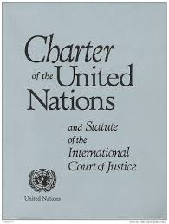
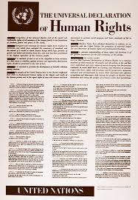
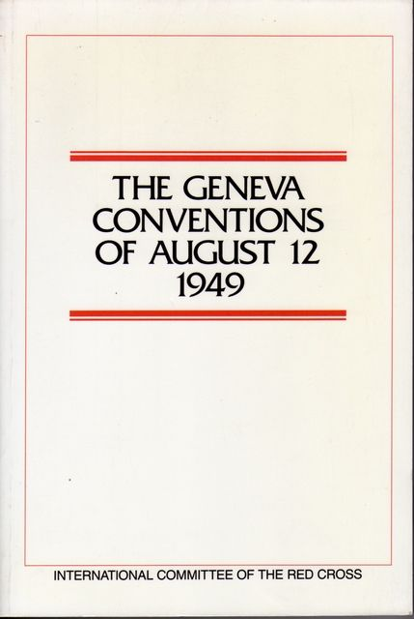
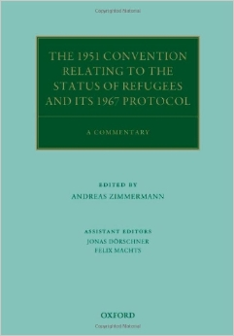
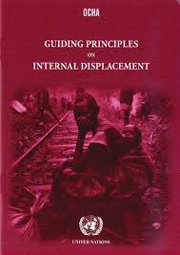
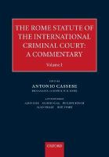
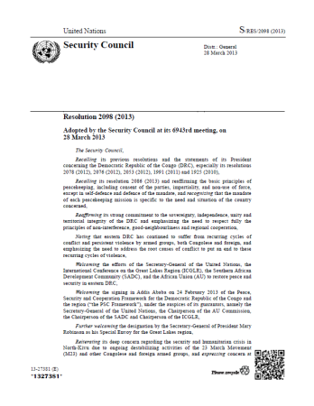
The Legal Framework for UN
Peacekeeping Operations
UN Core Pre-Deployment Training Materials 2016

Slide 8
UN Charter
A source of authority and legitimacy for UN peacekeeping
UN Core Pre-Deployment Training Materials 2016

Slide 9
Chapters Indicating Peacekeeping
Chapter I: One of the purposes of the UN is “to maintain international peace and security”
Chapter V: The Security Council has the “…primary responsibility for the maintenance of international peace and security...”
UN Core Pre-Deployment Training Materials 2016

Slide 10
Chapters Indicating Peacekeeping (cont.)
Chapter VI: Outlines a range of peaceful measures
Chapter VII: “…The Security Council...may take such action by air, sea or land forces as may be necessary...”
Chapter VIII: Provides for the involvement of regional partners in maintaining international peace and security
UN Core Pre-Deployment Training Materials 2016

Slide 11
Clarifying Chapter References
Legal basis for UN peacekeeping in Chapters VI and VII
References to Chapters VI and VII missions inaccurate and misleading
Chapter VI Mission
Chapter VII Mission
UN Core Pre-Deployment Training Materials 2016

Slide 12
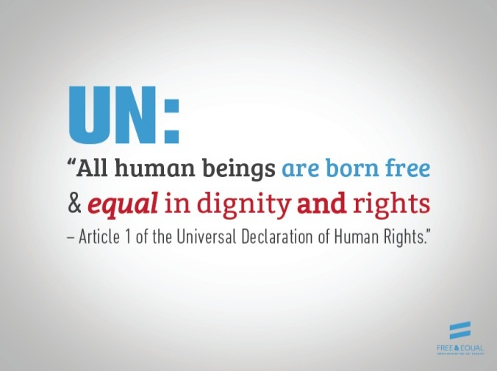
International Human Rights Law
What are Human Rights?
“Human rights” are rights inherent to all human beings, whatever our nationality, place of residence, sex, national or ethnic origin, colour, religion, language or any other status.
We are all equally entitled to our human rights without discrimination
UN Core Pre-Deployment Training Materials 2016

Slide 13
Examples of Human Rights
Examples of civil and political rights include the right to:
Life
Freedom from torture
Protection from discrimination
Freedom of expression
A fair trial
Not be held in slavery
UN Core Pre-Deployment Training Materials 2016

Slide 14
Examples of Human Rights
Examples of economic, social and cultural rights include the right to:
Join a trade union
Education
Food
Housing and medical care
Social security and work
Equal pay for equal work
UN Core Pre-Deployment Training Materials 2016

Slide 15
What is International Human Rights Law?
International law protecting fundamental human rights of every individual at all times
Applies both in war and peace, to all human beings
UN Core Pre-Deployment Training Materials 2016

Slide 16
Legal Sources
UN Charter
Universal Declaration of Human Rights
Covenant on Economic,
Social and Cultural Rights
Covenant on Civil
and Political Rights
(also referred to as International Bill of Human Rights)
Focus areas of specialized human rights treaties
Genocide
Refugees
Torture
Racial Discrimination
Disabilities
Children’s Rights
Trafficking
Disappearances
Discrimination Against Women
UN Core Pre-Deployment Training Materials 2016

Slide 17
International Humanitarian Law
What is International Humanitarian Law?
“Law of war” or “law of armed conflict”
Applies in times of armed conflict
Limits negative impact of armed conflict and reduces suffering during war
UN Core Pre-Deployment Training Materials 2016

Slide 18
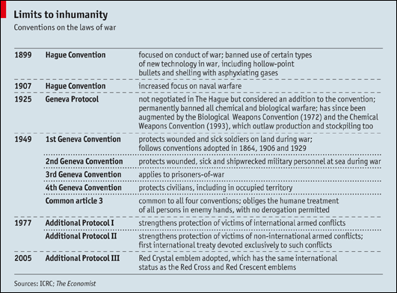
Legal Sources
UN Core Pre-Deployment Training Materials 2016

Slide 19
Secretary-General’s Bulletin on IHL
Fundamental principles and rules of IHL applicable to UN peacekeepers
UN military personnel who violate IHL are subject to prosecution in their national courts
UN Core Pre-Deployment Training Materials 2016

Slide 20
Essential Rules of IHL
Civilian targets cannot be attacked. Attacks only against military objectives.
Civilians and anyone no longer taking part in hostilities must be respected and treated humanely.
Anyone who surrenders or stops fighting (e.g., wounded) cannot be killed.
Torture is prohibited at all times and in all circumstances.
UN Core Pre-Deployment Training Materials 2016

Slide 21
Essential Rules of IHL (cont.)
Captured combatants and civilians must be respected and protected.
It is forbidden to use weapons or methods of warfare that are likely to cause excessive injury or unnecessary suffering.
Wounded and sick must be collected and cared for.
Medical personnel and medical establishments, transport and equipment must be respected and protected.
UN Core Pre-Deployment Training Materials 2016

Slide 22
Essential Rules of IHL (cont.)
The Red Cross, Red Crescent and Red Crystal emblems are signs of protection and must be respected.
Prevention and prosecution of war crimes covers attacking civilians, recruiting children as soldiers, torturing prisoners and sexual violence.
UN Core Pre-Deployment Training Materials 2016

Slide 23
International Refugee Law and Guiding Principles on Internally Displaced Persons
International Refugee Law guarantees human rights of refugees and details obligations of States to protect refugees in their territory
The Guiding Principles on Internal Displacement identifies rights and guarantees for protection of IDPs
UN Core Pre-Deployment Training Materials 2016

Slide 24
International Criminal Law
Governs prosecution of individuals for international crimes, including war crimes, crimes against humanity, genocide
Rome Statute of International Criminal Court (ICC) codifies International Criminal Law
UN Core Pre-Deployment Training Materials 2016

Slide 25
Additional Aspects of the Legal Framework
Security Council mandate
National law of host country
MOU between UN and T/PCCs
SOMA or SOFA
The Convention on the Privileges and Immunities of the UN of 1946
UN Internal Rules, Regulations
and Guidance
UN Core Pre-Deployment Training Materials 2016

Slide 26
Summary of Key Messages
Key documents in legal framework
Definition of human rights
Examples of human rights protected under IHRL
Who is protected by IHL?
Essential rules of IHL
UN Core Pre-Deployment Training Materials 2016

Slide 27
Questions
UN Core Pre-Deployment Training Materials 2016

Slide 28
Learning Activity
Learning Evaluation
UN Core Pre-Deployment Training Materials 2016

