Slide 1

Module 3: Individual Peacekeeping Personnel
Lesson
3.1
UN Core Values and Competencies

Slide 2

Aim
To introduce peacekeeping personnel to UN Core Values and Competencies.
UN Core Pre-Deployment Training Materials 2016

Slide 3
Relevance
Rich cultural and institutional diversity between military, civilian, police
Organizational Core Values and Competencies create a shared language
UN Core Pre-Deployment Training Materials 2016

Slide 4
Learning Outcomes
Learners will:
List UN Core Values and Competencies
Explain their importance
Describe different ways peacekeeping personnel gain UN Core Competencies
UN Core Pre-Deployment Training Materials 2016

Slide 5
Learning Overview
Definitions
Importance
UN Core Values
UN Core Competencies
Managerial Competencies
What Individual Peacekeeping Personnel Can Do
UN Core Pre-Deployment Training Materials 2016

Slide 6
Definitions
Organizational Core Values: shared principles and beliefs underpinning work of organization, and guiding actions and behaviours of staff
Organizational Core Competencies: skills, attributes and behaviours important for all staff
Managerial Competencies: skills, attributes and behaviours considered essential for staff with managerial/supervisory responsibilities
UN Core Pre-Deployment Training Materials 2016

Slide 7
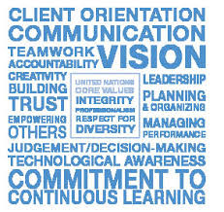
Why are UN Core Values and Competencies Important?
Capitalizes on the key to success for the UN Organization – the quality of its staff and managers
Creates organizational culture and environment enabling staff to contribute their maximum potential
Builds human resources capacity for the future
UN Core Pre-Deployment Training Materials 2016

Slide 8

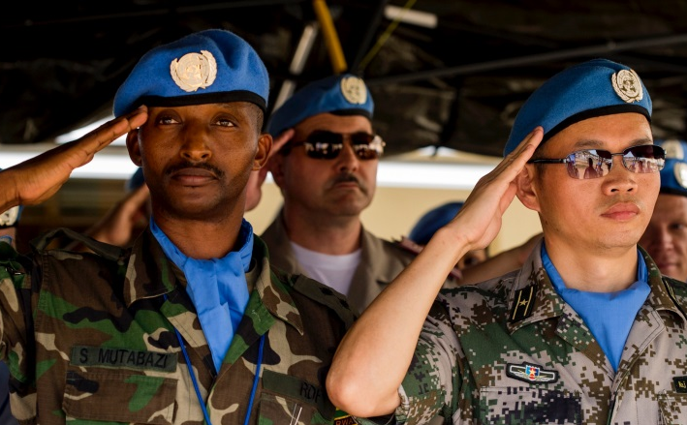

UN Core Values
Integrity
Professionalism
Respect for Diversity
UN Core Pre-Deployment Training Materials 2016

Slide 9
Integrity means…
to demonstrate the values of UN in daily activities and behaviours
to act without consideration of personal gain
to resist undue political pressure in decision-making
to stand by decisions in the organization’s interest, even if they are unpopular
not to abuse power or
authority
to take prompt action in
cases of unprofessional
or unethical behaviour
UN Core Pre-Deployment Training Materials 2016

Slide 10
Professionalism means…
to show pride in work and in achievements
to demonstrate professional competence and mastery of subject matter
to be conscientious and efficient in meeting commitments, to observe deadlines and to achieve results
to be motivated by professional rather than personal concerns
to show persistence when
faced with difficult
problems or challenges
to remain calm in stressful
situations
UN Core Pre-Deployment Training Materials 2016

Slide 11
Respect for diversity means…
to work effectively with people from all backgrounds
to treat all people with dignity and respect
to treat men and women equally
to show respect for and understanding of diverse points of view in daily work and
decision-making
to examine own biases
and behaviours to avoid
stereotypical responses
not to discriminate against
any individual or group
UN Core Pre-Deployment Training Materials 2016

Slide 12








UN Core Competencies
Communication
Teamwork
Planning and Organization
Accountability
Client Orientation
Creativity
Technological Awareness
Commitment to Continuous Learning
UN Core Pre-Deployment Training Materials 2016

Slide 13

Communication
UN Core Pre-Deployment Training Materials 2016

Slide 14
Teamwork
UN Core Pre-Deployment Training Materials 2016

Slide 15

Planning and Organization
UN Core Pre-Deployment Training Materials 2016

Slide 16
Accountability
UN Core Pre-Deployment Training Materials 2016

Slide 17
Client Orientation
UN Core Pre-Deployment Training Materials 2016

Slide 18

Creativity
UN Core Pre-Deployment Training Materials 2016

Slide 19

Technological Awareness
UN Core Pre-Deployment Training Materials 2016

Slide 20
Commitment to Continuous Learning
UN Core Pre-Deployment Training Materials 2016

Slide 21
Continuous Learning
DPKO/DFS Integrated Training Service
Deployment
Pre-Deployment Training PDT
Induction
On-Going
Training Phases
Member States
United Nations
Responsibility
In Country
In Mission
Location
UN Core Pre-Deployment Training Materials 2016

Slide 22
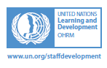
Continuous Learning
Office of Human Resources
Leadership, Management & Organizational Development
Human & Financial Resources Management
E-Learning
Career Support
Language and Communications
Staff Well-Being
Information Technology
Substantive and Technical Skills
UN Core Pre-Deployment Training Materials 2016

Slide 23

Managerial Competencies
Leadership
Vision
Empowering Others
Building Trust
Managing Performance
Judgment/Decision-Making
UN Core Pre-Deployment Training Materials 2016

Slide 24
What Individual Peacekeeping Personnel Can Do
Uphold, demonstrate and strengthen UN Core Values and Competencies
Acquire UN Core Competencies through:
  Training and learning activities
  Coaching and mentoring
  Feedback/appraisals
UN Core Pre-Deployment Training Materials 2016

Slide 25
Summary of Key Messages
UN Core Values and Competencies
Importance
Different ways peacekeeping personnel gain UN Core Competencies
UN Core Pre-Deployment Training Materials 2016

Slide 26
Questions
UN Core Pre-Deployment Training Materials 2016

Slide 27
Learning Activity
Learning Evaluation
UN Core Pre-Deployment Training Materials 2016

Slide 28
Comments
This presentation needs to specifically define Core Values. Slides 8, 9 and 10 need specific definitions that the audience can read. I inserted definitions from the notes. The pictures are not particularly helpful and are repeated from Slide 7 where they are shown already. I imported the definitions from the Final draft notes they are very good.

