Slide 1
Module 2: Mandated Tasks of United Nations Peacekeeping Operations
Lesson
2.4
Protection of Civilians

Slide 2
Aim
To detail duties of all peacekeeping personnel for the protection of civilians (POC).
UN Core Pre-Deployment Training Materials 2016

Slide 3
Relevance
POC is:
A priority for the Security Council
A responsibility for all peacekeeping personnel
UN Core Pre-Deployment Training Materials 2016

Slide 4
Learning Outcomes
Learners will:
Explain POC in UN peacekeeping
List examples of protection threats civilians face in armed conflict
Explain how peacekeeping personnel carry out the POC mandate as part of mission and as individuals
Describe the range of protection partners that operate alongside peacekeeping operations (PKOs)
UN Core Pre-Deployment Training Materials 2016

Slide 5
Learning Overview
Importance of Protecting Civilians
POC in UN Peacekeeping
Legal Framework
DPKO/DFS Policy on POC in UN PKOs
Operational Concept on POC
Implementing the POC Mandate
Roles and Responsibilities
Protection Partners
What Individual Peacekeeping Personnel Can Do
UN Core Pre-Deployment Training Materials 2016

Slide 6
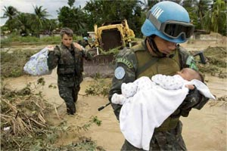
Importance of Protecting Civilians
Harmed unintentionally
Deliberate targets
Women and children suffer disproportionately
UN Core Pre-Deployment Training Materials 2016

Slide 7
POC in Peacekeeping
Interpretations of Protection
Rights-based approach
Stabilization and peacebuilding – durable forms of protection
Physical protection from harm
UN Core Pre-Deployment Training Materials 2016

Slide 8
POC Mandate
“All necessary means, up to and including the use of deadly force, aimed at preventing or responding to threats of physical violence against civilians, within capabilities and areas of operations, and without prejudice to the responsibility of the host government”.
UN Core Pre-Deployment Training Materials 2016

Slide 9
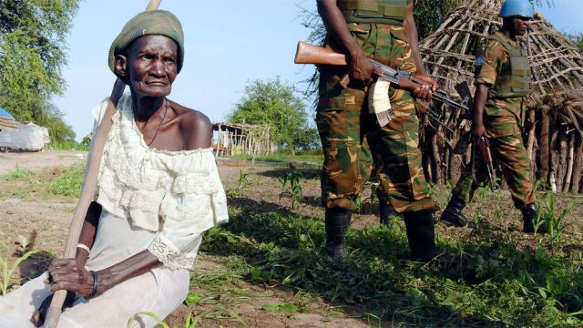
Civilian
Any person who is not or is no longer directly participating in hostilities or other acts of violence
UN Core Pre-Deployment Training Materials 2016

Slide 10
Threats
An impending or potential physical violence against civilians
Violations to right to life and physical integrity
Actions by state or international security/military forces
Mines, unexploded ordnance, improvised explosive devices
UN Core Pre-Deployment Training Materials 2016

Slide 11
Vulnerability Factors
Individual/Community Factors: | Age, gender, sex, ethnicity, religion, political affiliation and social status
Environmental Factors: | Geographic location, level of urbanization, proximity and capacity of state authority in the area, level of infrastructure and communication
Access to Assistance: | Ability to access services and interact
Self-Sufficiency: | Existence of self-protection strategies, including early-warning capacities, self-defence capacities or other strategies
UN Core Pre-Deployment Training Materials 2016

Slide 12
Complementary Concepts
Humanitarian protection
Human rights
Responsibility to protect (R2P)
UN Core Pre-Deployment Training Materials 2016

Slide 13
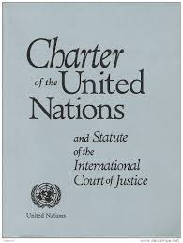
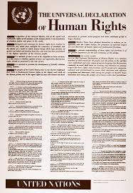
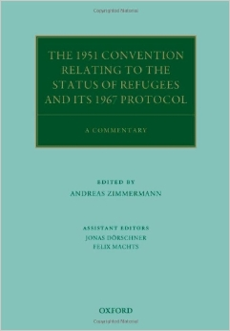
Legal Framework
UN Charter
International Humanitarian Law
International Human Rights Law
International Refugee Law
Rome Statute of the International Criminal Court
UN Core Pre-Deployment Training Materials 2016

Slide 14
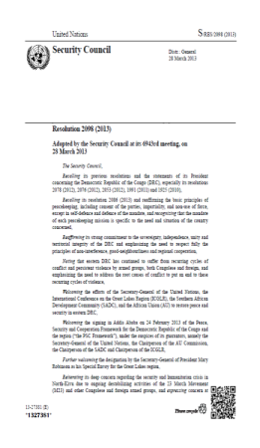
Legal Framework
Security Council resolutions
ROE and DUF
SOFA between UN and host country
National laws
UN Core Pre-Deployment Training Materials 2016

Slide 15
DPKO/DFS Policy on POC
Guiding Principles
Primary responsibility of host government
Grounded in international law
Whole of mission approach
Priority mandate
Cooperation with humanitarian actors
Obligation of peacekeeping personnel
Community-based approach
Impartiality
Gender perspective and child protection concerns
UN Core Pre-Deployment Training Materials 2016

Slide 16
DPKO/DFS Operational Concept on POC
Three Tiers
Tier I: Protection through dialogue and engagement
Tier II: Provision of physical protection
Tier III: Establishment of a protective environment
UN Core Pre-Deployment Training Materials 2016

Slide 17
Four Phases of Response
Prevention
Threat is latent (risk)
Pre-emption
Threat is identified
Response
Consolidation
Threat has been mitigated/eliminated
UN Core Pre-Deployment Training Materials 2016

Slide 18
Implementing the POC Mandate
Risk Analysis
high
Threat B
Threat D
Impact
Threat C
Threat A
low
Likelihood
high
UN Core Pre-Deployment Training Materials 2016

Slide 19
POC Response Planning
POC Strategy: Primary tool at mission level to implement POC mandate and plan responses to POC threats
Operational level guidance, joint action, coordination for all mission components
UN Core Pre-Deployment Training Materials 2016

Slide 20
Roles and Responsibilities
Protection Adviser
Supports and advises mission leadership
Development and regular review of mission-wide POC strategy
Advisory, coordination, monitoring & reporting role
Integrates POC concerns across the mission
Goal
Protection of Civilians
UN Core Pre-Deployment Training Materials 2016

Slide 21
Focusing and contributing
Protection Functions
Women Protection Adviser
Child Protection
Human Rights
Gender Adviser
Civil Affairs
Political Affairs
Rule of Law/Judicial Affairs
SSR
DDR
JOC/JMAC
Public Information
Mission Support
DSRSG/RC/HC
SRSG’s Office
UN Core Pre-Deployment Training Materials 2016

Slide 22
Special Roles of Military and Police
Physical protection
Proactive approach
Monitoring and reporting
Protection of Civilians
UN Core Pre-Deployment Training Materials 2016

Slide 23
Joint Protection Teams
Coordinated by POC Adviser
Composed of military, police, civilians
Gathers information on protection situations
UN Core Pre-Deployment Training Materials 2016

Slide 24
Protection Partners
Host state government
Local communities
UN partners – UNHCR, OHCHR, OCHA, UNICEF
ICRC
Non-UN military forces
NGOs, civil society organizations – national, international
UN Core Pre-Deployment Training Materials 2016

Slide 25
Coordination
National Authorities: | Political engagements; security sector reform programmes; targeted advocacy; joint operations or joint patrolling
Local Communities: | Dialogue with local population; mission-wide community engagement cooperation mechanisms such as Joint Protection Teams, Community Liaison Assistants, Community Alert Networks, localized protection strategies
Humanitarian Community: | Protection Cluster led by UNHCR
Parallel Forces | Information sharing and operational planning on a case-by-case basis, including HOM exchanges and working-level cooperation
UN Core Pre-Deployment Training Materials 2016

Slide 26
What Individual Peacekeeping Personnel Can Do
Engage local communities
Understand POC mandate, environment, threats
Cooperate with mission components and partners
Interpret the POC mandate pro-actively, try to prevent threats
UN Core Pre-Deployment Training Materials 2016

Slide 27
Summary of Key Messages
POC in UN Peacekeeping
Main protection threats civilians face in armed conflict
How peacekeeping personnel carry out the POC mandate as part of mission and as individuals
The range of protection partners that operate alongside PKOs
UN Core Pre-Deployment Training Materials 2016

Slide 28
Questions
UN Core Pre-Deployment Training Materials 2016

Slide 29
Learning Activity
Learning Evaluation
UN Core Pre-Deployment Training Materials 2016

