Slide 1
Module 1: An Overview of United Nations Peacekeeping Operations
Lesson
1. 3
The Basic Principles of UN Peacekeeping

Slide 2
Aim
To introduce the basic principles and success factors of UN peacekeeping and explain how
to put them in to practice
UN Core Pre-Deployment Training Materials 2016

Slide 3
Relevance
The Basic Principles:
Direct UN peacekeeping
Must be known, understood, applied
UN Core Pre-Deployment Training Materials 2016

Slide 4
Learning Outcomes
Learners will:
List the basic principles and key success factors
Explain “legitimacy” and “credibility”
Describe how peacekeepers support legitimacy and credibility
Explain “national and local ownership” and why essential to success
UN Core Pre-Deployment Training Materials 2016

Slide 5
Learning Overview
The Basic Principles
Consent
Impartiality
Non-Use of Force Except in Self-Defence & Defence of the Mandate
Other Success Factors
Legitimacy
Credibility
Promotion of National & Local Ownership
UN Core Pre-Deployment Training Materials 2016

Slide 6
The Basic Principles of UN Peacekeeping
Consent
Impartiality
Non-use of force except in self-defence and defence of the mandate
UN Core Pre-Deployment Training Materials 2016

Slide 7
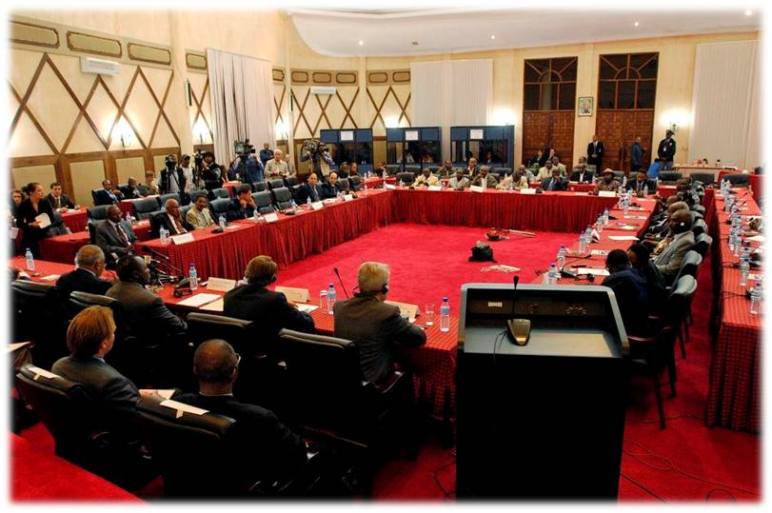
Basic Principle #1: Consent
All UN peacekeeping operations deploy at least with consent of the host authorities
UN Core Pre-Deployment Training Materials 2016

Slide 8
Consent: What Peacekeepers Can Do
Continuously scan and analyse environment
Learn about host country
Assess and report on parties
Build and respect trust
UN Core Pre-Deployment Training Materials 2016

Slide 9
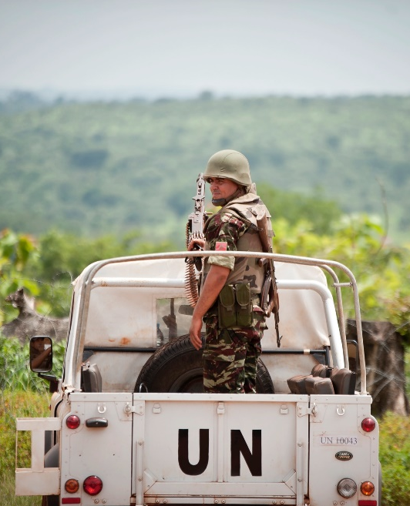
Basic Principle #2: Impartiality
UN PKOs implement mandates without favour or prejudice
UN Core Pre-Deployment Training Materials 2016

Slide 10
Impartiality: What Peacekeepers Can Do
Build relationships
Avoid activities compromising impartiality
Rationale for action well-established and communicated
Public information
communications and key
messages enforced
UN Core Pre-Deployment Training Materials 2016

Slide 11
Basic Principle #3: Non-Use of Force Except in Self-Defence & Defence of the Mandate
Use of force permitted in self-defence and defence of mandate
Security Council authorizes “all necessary means” to defend the mandate
UN Core Pre-Deployment Training Materials 2016

Slide 12
Non-Use of Force: What Peacekeepers Can Do
Exercise restraint
Precise, proportional and appropriate use
Early de-escalation of violence, non-violent means of persuasion
ROE or DUF
UN Core Pre-Deployment Training Materials 2016

Slide 13
Other Success Factors
Legitimacy
Credibility
Promotion of National and Local Ownership
UN Core Pre-Deployment Training Materials 2016

Slide 14
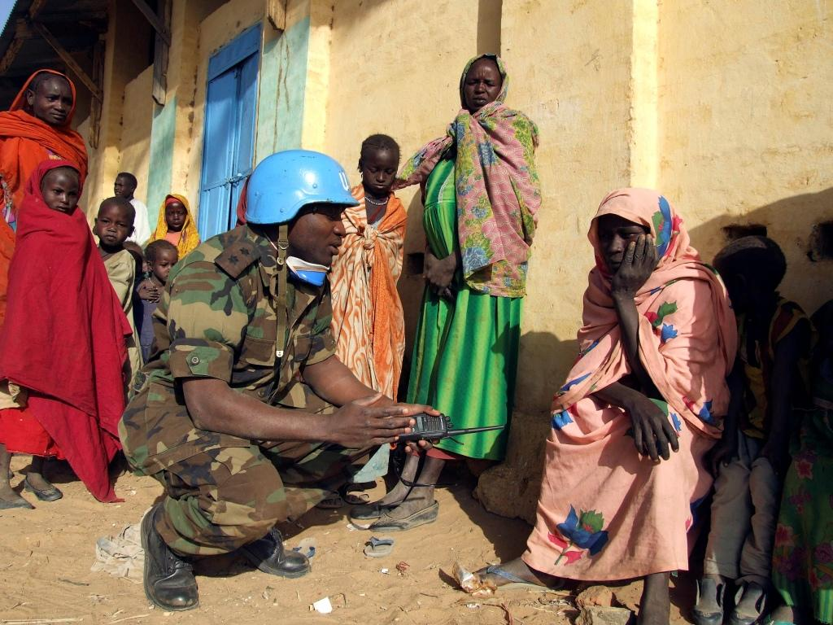
Success Factor #1: Legitimacy
UN PKOs have international legitimacy
Quality and conduct of personnel affect perceived legitimacy
UN Core Pre-Deployment Training Materials 2016

Slide 15
Legitimacy: What Peacekeepers Can Do
Maintain high standards of professionalism, competence, integrity
Respect local population
Zero tolerance for sexual exploitation and abuse
UN Core Pre-Deployment Training Materials 2016

Slide 16
Success Factor #2: Credibility
Depends on achieving mandate
Affected by ability to manage and meet expectations
UN Core Pre-Deployment Training Materials 2016

Slide 17
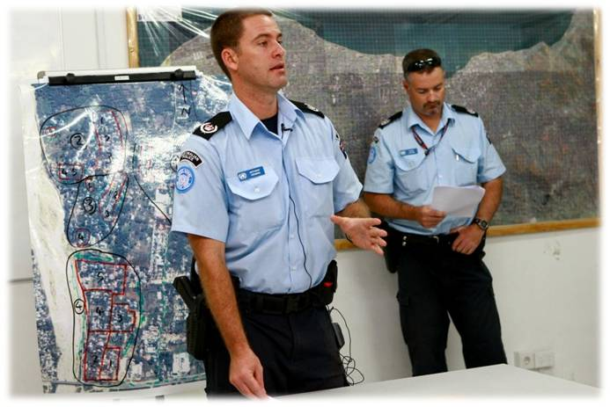
Credibility: What Peacekeepers Can Do
Implement Mandate
Remain confident, capable, unified
Manage expectations
UN Core Pre-Deployment Training Materials 2016

Slide 18
Success Factor #3: Promotion of National & Local Ownership
Inclusive and consultative processes
Include local and national perspectives
Allow national capacity to lead
UN Core Pre-Deployment Training Materials 2016

Slide 19
Promotion of National and Local Ownership: What Peacekeepers Can Do
Respect national sovereignty
Support and build national capacity
Build trust, cooperation
Be sensitive to local needs,
perspectives
UN Core Pre-Deployment Training Materials 2016

Slide 20
Summary of Key Messages
Basic principles and key success factors
“Legitimacy” and “credibility”
Peacekeepers support to legitimacy and credibility
“National and local ownership” – essential to success
UN Core Pre-Deployment Training Materials 2016

Slide 21
Questions
UN Core Pre-Deployment Training Materials 2016

Slide 22
Learning Activity
Learning Evaluation
UN Core Pre-Deployment Training Materials 2016

