Slide 1
Module 1: An Overview of United Nations Peacekeeping Operations
Lesson
1. 2
Peace and Security Activities

Slide 2
Aim
To show the range of peace and security activities undertaken by the United Nations
UN Core Pre-Deployment Training Materials 2016

Slide 3
Relevance
Personnel work in a wider frame – peacekeeping is:
One of many UN peace and security activities
Unique and important
Connected to other UN security, development, humanitarian and human rights work
UN Core Pre-Deployment Training Materials 2016

Slide 4
Learning Outcomes
Learners will:
Describe 5 types of peace and security activities
Explain differences between “robust peacekeeping” and “peace enforcement”
Explain differences between traditional and multidimensional peacekeeping
List examples of 3 types of peacekeeping
Identify Security Council as authorizing body
UN Core Pre-Deployment Training Materials 2016

Slide 5
Learning Overview
The Spectrum of Peace and Security Activities
Linkages and Overlaps in Peace and Security Activities
Different Types of Peacekeeping Operations
Special Political Missions
UN Core Pre-Deployment Training Materials 2016

Slide 6
The Spectrum of Peace and Security Activities
Conflict Prevention
Conflict
Peacemaking
Peace Enforcement
Post-Conflict Peacebuilding and Preventing Relapse to Conflict
Peacekeeping
Cease-fire
Political Process
UN Core Pre-Deployment Training Materials 2016

Slide 7
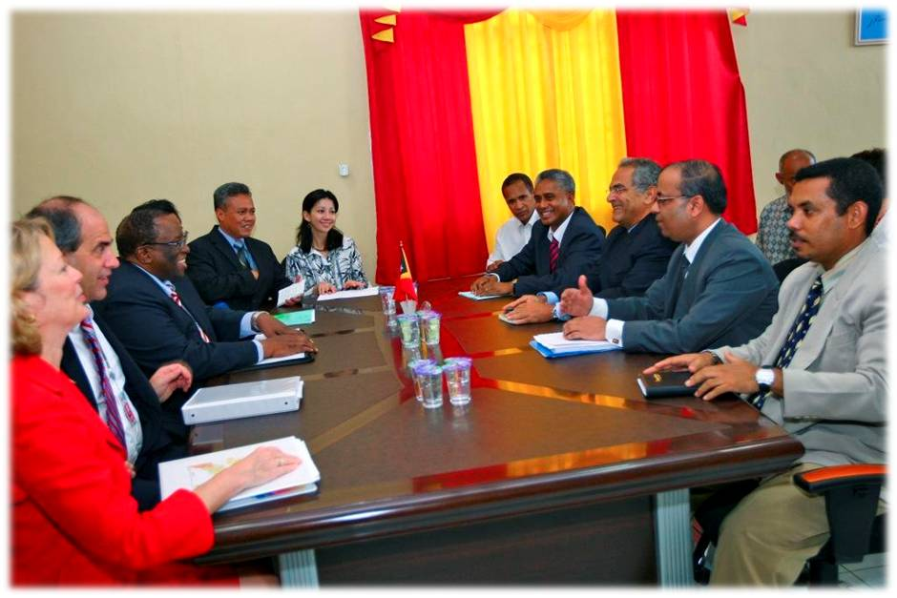
Conflict Prevention
Diplomatic measures and other tools to prevent violent conflict
UN Core Pre-Deployment Training Materials 2016

Slide 8
Peacemaking
Diplomatic action bringing hostile parties to an agreement
UN Core Pre-Deployment Training Materials 2016

Slide 9
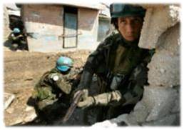
Peace Enforcement
Coercive measures, such as sanctions or blockades
Military force only with Security Council authorization
Authorized without consent of conflict parties
UN Core Pre-Deployment Training Materials 2016

Slide 10
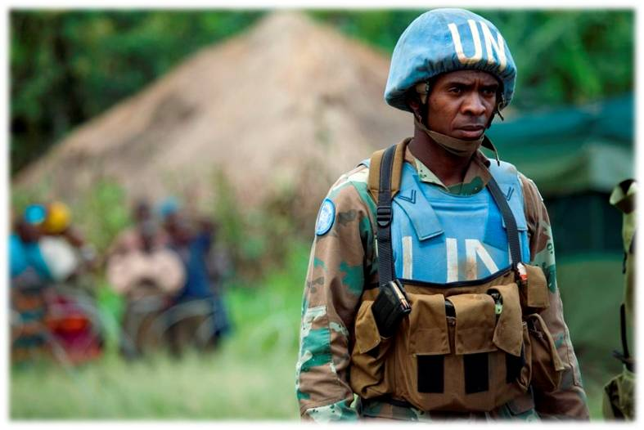
Peacekeeping
Preserves peace when fighting ends
Implements peace agreement
Authorized with consent of conflict parties
UN Core Pre-Deployment Training Materials 2016

Slide 11
Peace Enforcement vs. Robust Peacekeeping
Peace enforcement: coercive measures (strategic level), including the use of military force without consent of the parties
Robust peacekeeping: use of force with the consent of the parties
Security Council authorization for use of force
UN Core Pre-Deployment Training Materials 2016

Slide 12
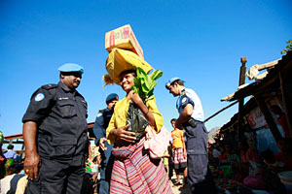
Peacebuilding
Long-term process, creates conditions for lasting peace, works on root causes of conflict
UN Core Pre-Deployment Training Materials 2016

Slide 13
Linkages and Overlaps in Peace
and Security Activities
Conflict Prevention
Conflict
Peacemaking
Peace Enforcement
Post-Conflict Peacebuilding and Preventing Relapse to Conflict
Peacekeeping
Cease-fire
Political Process
UN Core Pre-Deployment Training Materials 2016

Slide 14
Different Types of Peacekeeping Operations
UN Core Pre-Deployment Training Materials 2016

Slide 15
Different Types of Peacekeeping Operations
Traditional peacekeeping
Multi-dimensional peacekeeping
Transitional authority
UN Core Pre-Deployment Training Materials 2016

Slide 16
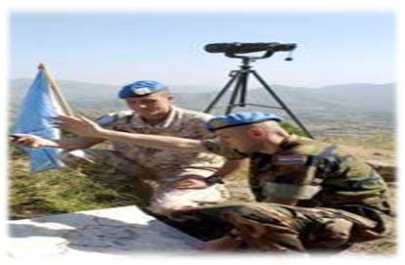
Traditional Peacekeeping
Temporary measures to manage conflict
Creates safer conditions for peacemaking
Primarily military model
UN Core Pre-Deployment Training Materials 2016

Slide 17
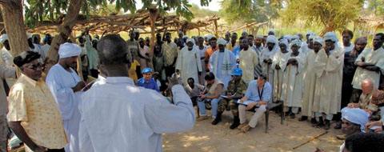
Multidimensional Peacekeeping
Deployed after internal conflict
Creates secure and stable environment
Supports implementation of peace agreement
Mix of military, police and civilians
UN Core Pre-Deployment Training Materials 2016

Slide 18
Transitional Authority
Multi-dimensional peacekeeping
Temporary State functions
UN Core Pre-Deployment Training Materials 2016

Slide 19
Special Political Missions
UN Core Pre-Deployment Training Materials 2016

Slide 20
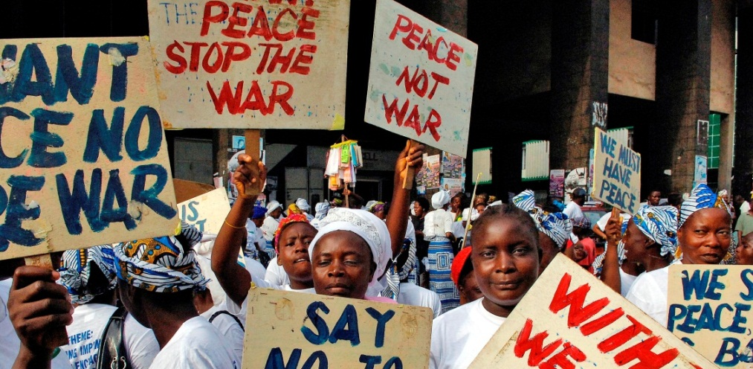
Special Political Missions
For conflict prevention, peacemaking, peacebuilding or peace enforcement
3 types:
Field missions
Special Envoys
Experts panels
UN Core Pre-Deployment Training Materials 2016

Slide 21
Summary of Key Messages
5 types of peace and security activities
“Robust peacekeeping” and “peace enforcement”
Traditional and multidimensional peacekeeping
3 types of peacekeeping
Security Council as authorizing body
UN Core Pre-Deployment Training Materials 2016

Slide 22
Questions
UN Core Pre-Deployment Training Materials 2016

Slide 23
Learning Activity
Learning Evaluation
UN Core Pre-Deployment Training Materials 2016

